Slide 1


Trauma informed project
Notes:
https://www.youtube.com/watch?v=waeRP6jzW_U

Slide 2
The Journey
2022
Planning the project and commissioning
2023
Day 1 consultations in all settings
2024
Project meeting 2 & 3
2 staff per setting to be trained in the 10 day Diploma TiSUK practitioner award.
September 2023 1 day whole staff INSET
Project meeting 1
Day 2 consultation
Celebration event.

Slide 3
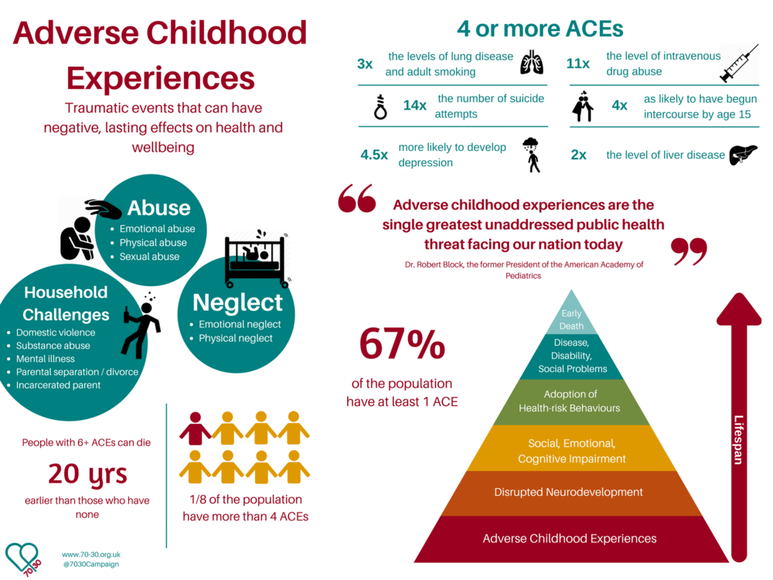
Notes:
The ACE study and protective factors
The ACEs study one of the biggest PH studies of all time 17,000 people. The study found that ACE are the leading determinant of the most common forms of physical/ mental illness and early death.
It is a message of hope not a message of gloom because research shows that this suffering is preventable
Research shows that protective factors namely interventions by an emotionally-available adults, before the age of 18, can interrupt the trajectory from childhood adversity to challenging behaviour, learning disabilities, long term mental, physical and social ill health
ACES questionnaire http://www.odmhsas.org/picis/TraningInfo/ACE.pdf
Adverse Childhood Experiences (ACEs) are stressful events occurring in childhood including
5 Personal
Emotional Abuse (humiliated/sworn at/ put down/insulted)
Emotional Neglect (Feeling unspecial/not important/ not loved/ not supported)
Physical Abuse (push, grab, slap, throw things at you)
Physical Neglect (not enough to eat/dirty clothes)
Sexual abuse
5 related to family members
Witnessing domestic violence
Loss of a parent or parent separation or divorce
A parent with a mental health condition
A member of the household being in prison
growing up in a household in which there are adults experiencing alcohol and drug use problems.

Slide 4
The 3 theory models behind the training
Model Two
The neuroscience of mental health and mental ill-health, with particular reference to Panksepp’s emotional systems
RAGE
FEAR
PANIC/GRIEF
CARE
SEEKING
PLAY
Model Three
P and 3R’s
PROTECT
RELATE
REGULATE
REFLECT

Slide 5
Settings and common trends
St Thomas Werneth
St Thomas Moorside
St Martin's
Crompton Primary
Christ Church Denshaw
Bare Trees
Holy Cross
Holy Family
St Paul's
EC St James
Increasing the universal offer for self regulation
Behaviour systems in place that reduces shame
Bringing the outdoors in
Increase time outdoors to maximise Biophilia
Teaching neuroscience about the brain within the curriculum

Slide 6
School Showcase

Slide 7
A Whole school Approach
Our priority within the school setting has been to ensure the psychological safety of our children. As a result of TISUK training we understand how the brain cannot function optimally when fear and adversity is present (Panksepp, 2011) . Thus, the implementation of PRR’S within our policy has helped us create an ethos of peace and positive relational experiences around school. Examples of this are:
Relationship Heals
Protect
Relate
Regulate
Reflect
All staff must aim to develop positive, non-judgmental working alliances with parents and children (Protect, Relate):
WINE sentence stems shared and used by all staff
PACEful approaches used throughout all interactions
Key relational skills practiced and modelled
Implementing practical working strategies: staff are to be fair, flexible, trustworthy, respectful and model positive relationships (Protect, Relate).
Prioritise staff wellbeing:
identifying expectations of each other e.g. drains and radiators
breaking stigmas around mental health providing space to talk and explore
Staff attended formal trauma informed training sessions
Explored the importance and role of an emotionally available adult
Adverse childhood experiences (ACE’s)
Neuroscience, how trauma effects brain and development
Use regulatory and reflective tools throughout our interactions create meaningful relationships:
Key relational skills
Safe spaces around the school
Regulation strategies
Notes:
St Pauls

Slide 8
Implementation of IMPACT OF RELATIONSHIP AND POLICY
Relationship Heals
Protect
Relate
Regulate
Reflect
Staff were encouraged to practice using the WINE statements within their daily interactions with all children (Protect, Relate):
Some children showed more engagement within conversations and began opening up more in discussions (fear of judgment ‘getting it wrong’ reduced)
Highlighted children who could/could not articulate thoughts and emotions – aided 1:1 referral process’
Impacted on staff mental wellbeing, some teachers felt that it helped them gain deeper insights into their class and informed their planning (helped model better peer relations) and opened up better conversations with SLT
Reflect and complete case studies on children of their choice
Meet and greets (protect): the importance of how meeting your class through various transitions throughout the day and showing visible delight in them- activating a child’s CARE system
Consistent adult at door in the morning
Emotional thermometers - affect attunement
Allows us to identify and address issues first thing, minimize toxic stress
Tailored meet and greets e.g. regulation around the mile track
End and send e.g. helps reflect and regulate anxieties from the day and set goals for the next day
Rise and shine club: encouraged for children with low levels of emotional wellbeing and anxiety based school avoidance: e.g. child who struggled with transition to school is now attending as mum is able to drop off in the morning
Notes:
St Pauls

Slide 9
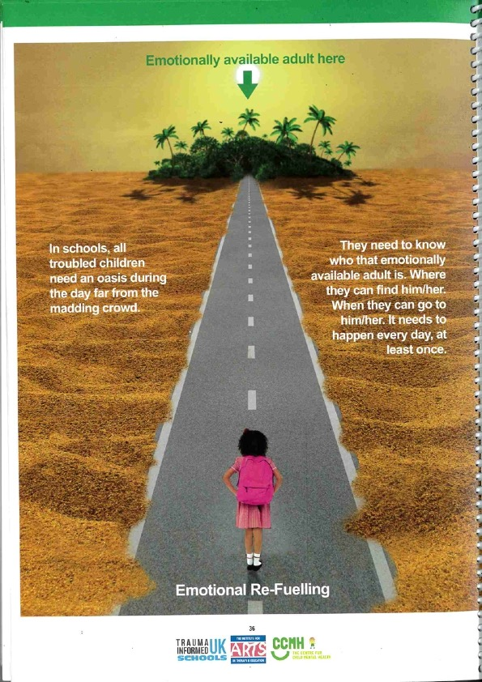
Clear communication between staff and parents (relate, regulate):
PCR’s aid reflective discussion
Ensure adults are aware of the child via a holistic approach
Staff wellbeing (protect):
wellbeing sessions planned in e.g. Tindell hills
Time for me time for you
Emotionally available adults (protect, relate, regulate):
Children are able to seek out adults to help them regulate, sometimes those adults may not be in their class or teaching staff e.g. Simon and Mrs Lees
Shining conversations- behaviour policy reduces shame and maintains relationship, children can verbalise certain behavioursand express reasoning and outcomes
Embed regulation strategies throughout school routine (regulate):
Sensory circuits - understand how using regulatory and reflective tools to create meaningful interactions - lead to supporting resilience, helps to repair trauma and and build relationships- move children out of blocked trust and self help to help and trust
Guinea pigs- Soothing and containment
Children are able to self regulate at the bubbles
Breathing breaks offered throughout the day
Mindfulness area’s within class
Neuroscience- myHappyMind
Apologising (relate and reflect): supported a midday though a restorative conversation with a child who had been wrongly put at fault. Midday was able understand and recognise the concept of empowered anger and engage in a restoratative conversation. Able to return to class after that and engage in learning.
Notes:
St Pauls

Slide 10
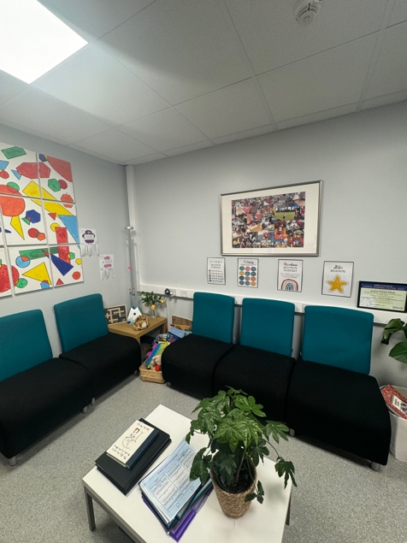
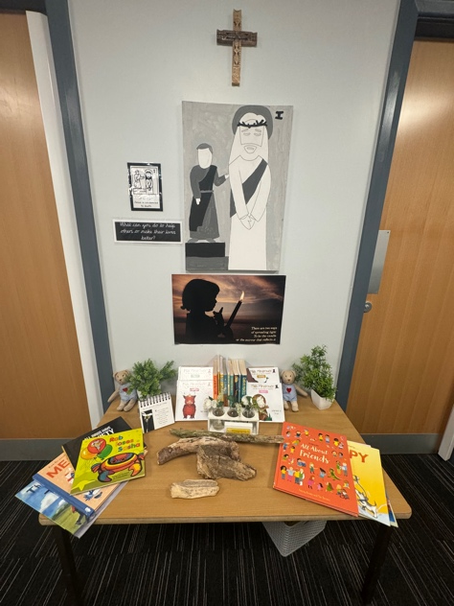
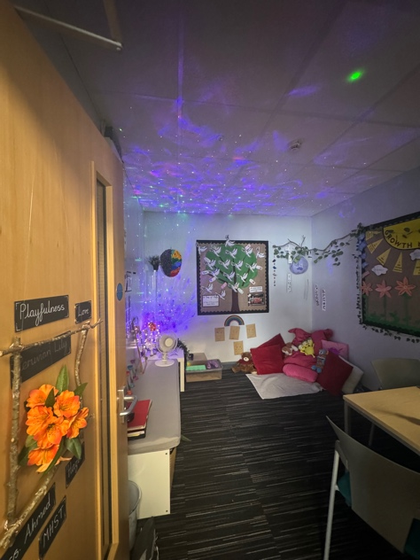
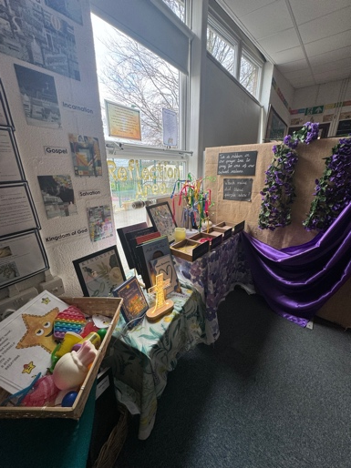
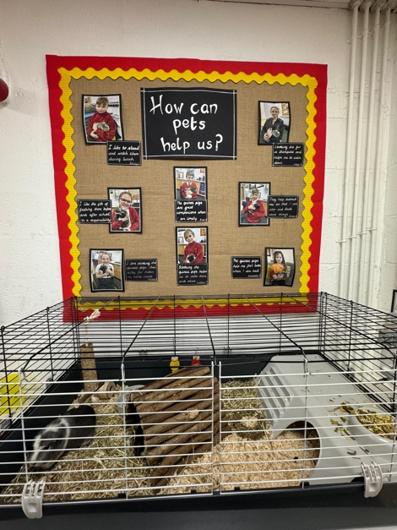
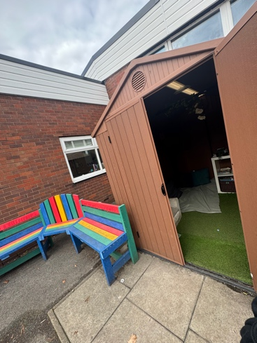
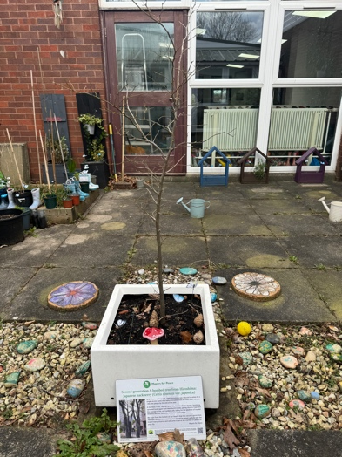
School environment
Biophillia- ‘A place of awe and wonder’.
Ensuring that the school actively supports the triggering of oxytocin (anti-stress chemical) in children’s brains through the practice of creating and using safe, sensorially rich and nurturing environments (Uvnas-Moberg, 2011). We have shifted towards ganing inspiration f the outdoors for its neurochemically protective factors (phytoncides emitted from trees) and mimic inside to support regulation and improve mental and physical health
”Bubbles area” used as a space for children to co/self regulate.
Restorative conversations usually happen here.
Regulation/reflection areas in class, designed to promote safety, curiosity and wonder.
Hessian displays – staff wellbeing
Quad garden and forest school elicit hard fascinations
Notes:
St Pauls

Slide 11
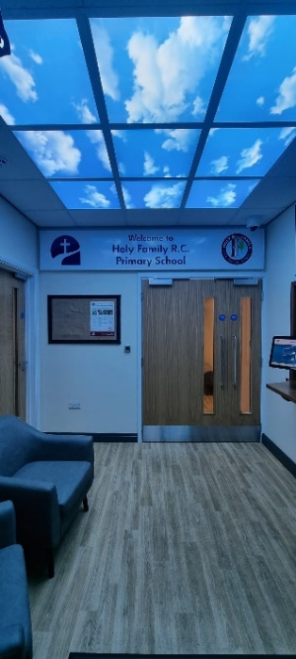
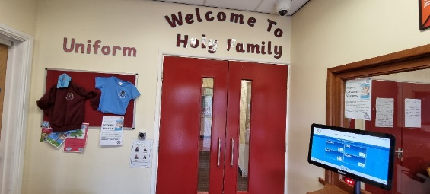
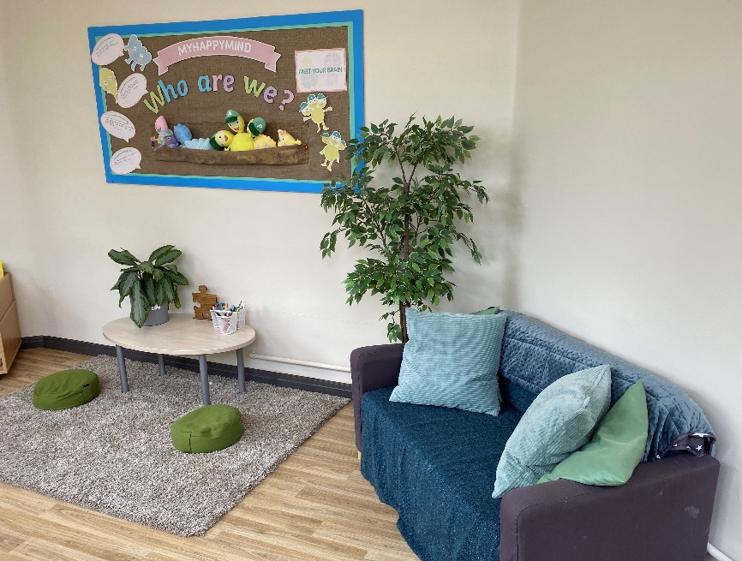
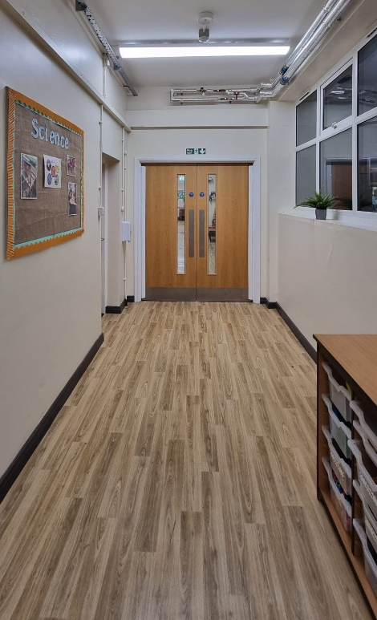
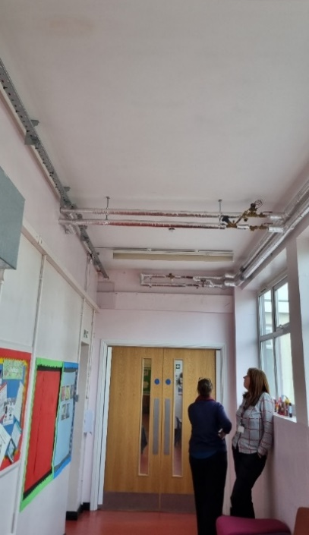
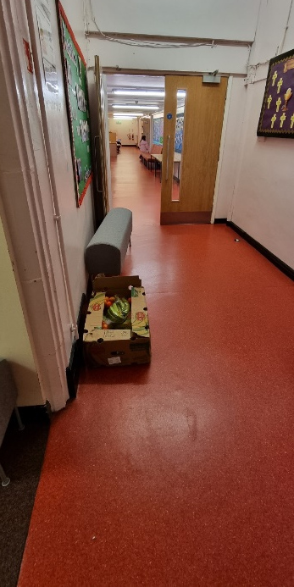
Our Environment
Calm Corner
“The Couch”
Notes:
Holy Family
We have been lucky as we had some money from the conversation to the Trust to improve the learning environment. We had been chipping away it for the last 6 years but it was major things like the toilets, fire alarm etc.
The décor was hideous! Red/orange floor and pink walls. Staff did their best to make the school attractive through bright display to detract from the décor, but it was grim.
So we went for wood effect floor neutral walls and it has transformed the school, lighting has also recently been done which again has had a massive impact.

Slide 12
Impact
Much calmer atmosphere throughout, children take pride in their school
A greater consistency in displays
A safe space for children in crisis, they know they will get help.
The “Couch” provides a consistent approach for the children. They know what will happen, we listen and empathise. PACE is key.
Notes:
The children know that the calm corner is a safe space, and that an adult is there to help them, they have the option to talk or just take time. There is always the expectation though that when they are ready we will listen to them. Initially for some children this would take a long time for them to open up, but know children will speak to us virtually straight away I believe this is because they know they will be really to. Some children still find it hard to accept there part in what ever incident has happened, but the progress they are making is good. I know that eventually this will happen, we have already seen the shoots of this, through apologies to staff off their own back.

Slide 13
Rules became school expectations
Whole school Trauma Training
Warnings became reminders
Relationship/Behaviour Policy
Reflections became an opportunity to build an understanding of the child through an empathic conversation
Staff really listen to understand what the child is trying to communicate
Staff really reflect on their own actions
Notes:
Our previous behaviour policy had been developed with the support of the SEMHs team. Staff had had ACES training and the policy was very based around teaching the children.
However, the training really made us reflect on the hidden messages that our policy was giving. Whole school trauma training was fantastic for us as everyone received the same message and staff found it really informative and useful, we were all on the same page.
The language was key. We used Paul Dix’s Ready Respectful and Safe. Reflections happen when a child has received 3 reminders, the reflections take place as soon as is possible for the teacher. We did start with a a list of questions, but this had become a check list and staff filled it in as they went along.
Now following the training Reflections are an empathic conversation. Staff really listen to the child and question sensitively and empathise. It really helps to rebuild relationships and has led to staff really reflecting on their own actions. It has also built a greater understanding of the child .

Slide 14
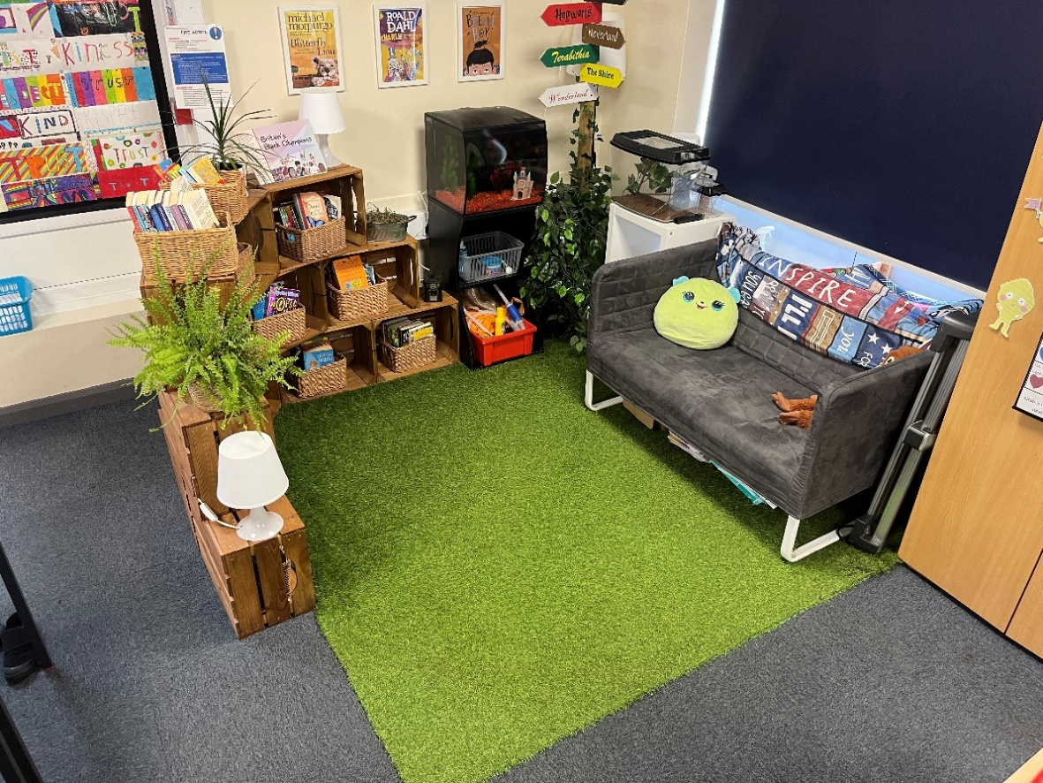
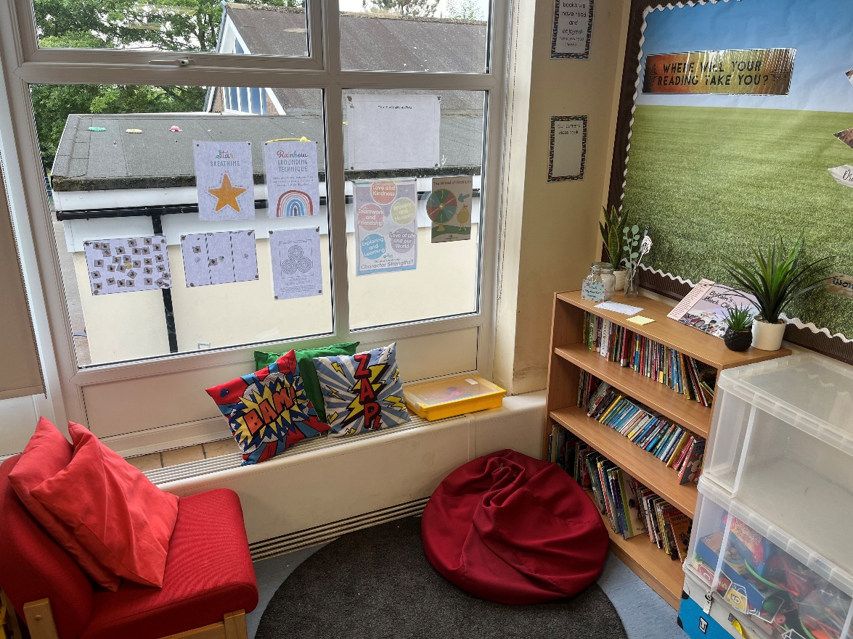
All children have access to regulation stations and calm areas within their classrooms to support their self-regulation, emotional and mental wellbeing. These regulation areas promote a calm, safe and warm environment for our children to use when emotionally distressed.
The use of having calm areas within each class have had a massively beneficial impact on our children’s emotional wellbeing and overall behaviour in school.
Notes:
EC St James

Slide 15
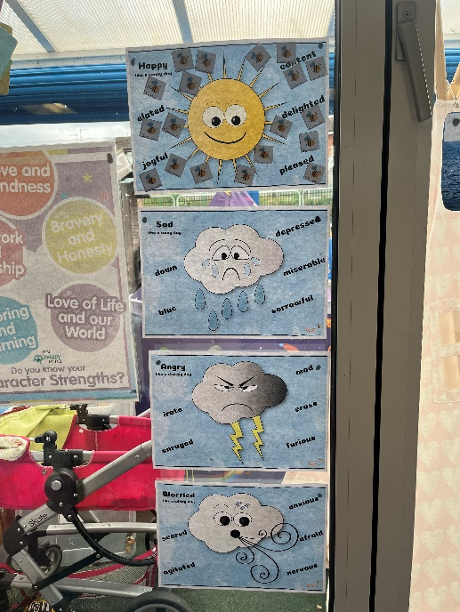
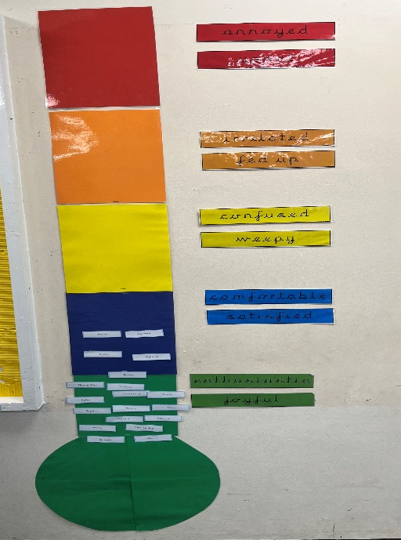
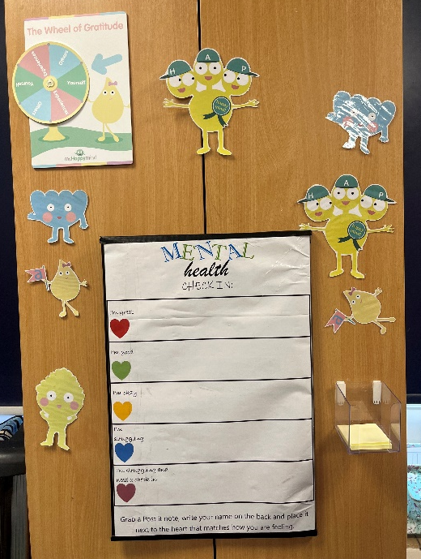
In our schools we have increased the universal offer for our children to access emotional registers in their classrooms. Every morning children are able to use the emotional register to identify how they are feeling.

Slide 16
Reflections
Therapeutic Environments
Change of language which has reduced behaviour escalations
More learning to improve emotional and social learning
Regulation stations areas
Relationships policy
Biophilia getting outdoors

