Slide 1

Introduction to WellComm
Delivered by: The ELSEC Team
Notes:
WellComm is a screening toolkit and follow-up intervention that can be used to identify and support children with language and communication difficulties. It is not a diagnostic tool, nor is it a standardised assessment. It simply aims to give a profile of a child’s strengths and areas to work on. It is an English screening toolkit based on English language developmental norms/expectations. For more information around screening and using WellComm with multilingual children please watch ‘How to use the toolkit with EAL children’....

Slide 2
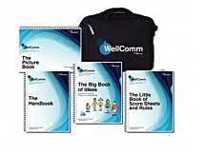
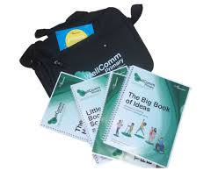

Early Years
0-6 years
Primary
6-11 years
Notes:
WellComm was devised by two speech and language therapists. There are currently two WellComm toolkits – WellComm early years, for children aged 0-6 years, and WellComm Primary, for children who are 6-11 years old. Whilst WellComm early years provides an overview of a child’s play skills and their receptive and expressive language skills, WellComm Primary focuses more on a child’s understanding of language, vocabulary and narrative skills. Please note, that speech sounds are not covered assessed by WellComm.
With the growing rate of speech, language and communication needs in Oldham, WellComm can help by ensuring early, identification and targeted intervention. Many children will make good progress if WellComm is used effectively in settings, and for those who don’t, WellComm provides adequate evidence when making a referral to the speech and language service.
The next few videos will cover:
How to carry out the screen (Early years and Primary)
How to carry out the interventions (Early years and Primary)
And how to embed WellComm into your classrooms
Please note, this training is for those following the paper version of WellComm - it does not cover WellComm digital. Information about Wellcomm digital can be found on their website.

