Slide 1

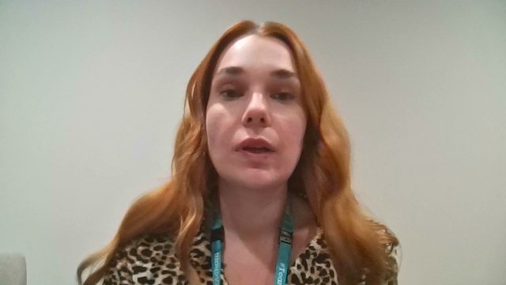
How to use the Early Years Big Book of Ideas and the intervention toolkit
Delivered by: The ELSEC Team
Notes:
Once children’s language levels and profiles have been completed it is important that high quality support is put in place as quickly as possible.
The WellComm toolkit provides this for you in the form of the Big book of ideas.

Slide 2

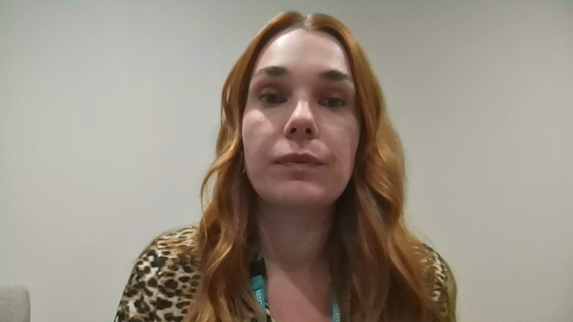
Notes:
The activities that are provided in the BBOIs are designed to be delivered in 1 -1 sessions or in small group sessions, with a maximum of 6 children.
If you plan to deliver the interventions in small groups, you need organise the children, so that they are grouped in to similar language levels.
As previously mentioned, the BBOIs is the key tool to delivering the required support. The activities can be delivered by any practitioner that works with the children.
The book is in colour coded sections which correspond to the score sheets that you used to screen the children.
Remember, you need to start the intervention the section ABOVE the child’s green outcome.
So, for example, if a 5-year-old child is green on section 7 (Early Years) they will need to start their intervention at section 8.
Each section contains activities on how to develop language skills within each particular age range.
To help you find your way around the BBOIs each section follows the same format:

Slide 3
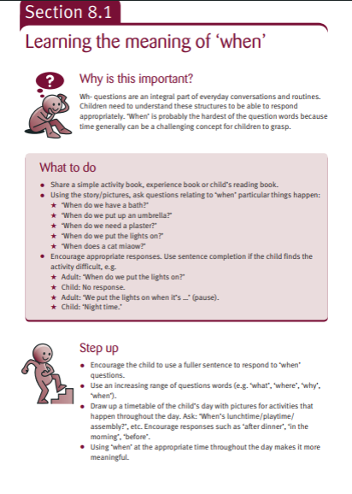
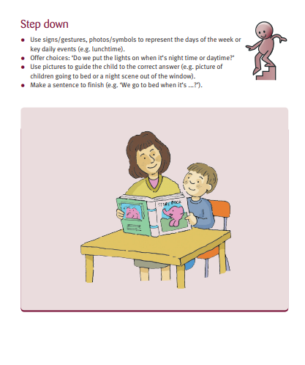
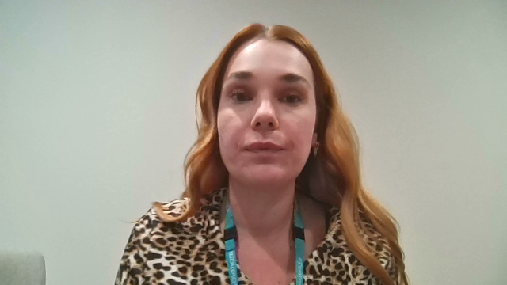
Notes:
The title describes the aim of the activity,
The ‘why it is important’- describes the rationale behind the aim so you can be sure that the activity will meet the child’s need.
What to do- clearly outlines the activity.
Each activity can also be differentiated with a ‘step up’ or ‘step down’ activity to add or reduce the level of challenge.

Slide 4
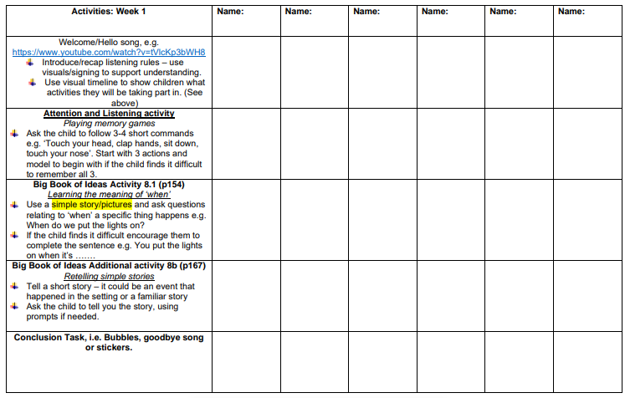
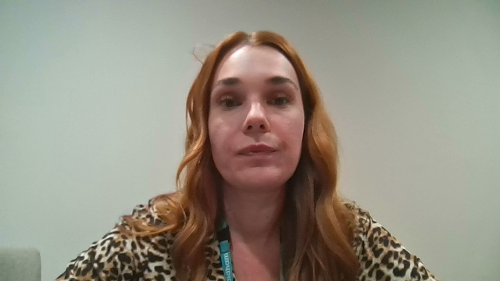
Notes:
The ELSEC team, in conjunction with the Better Communication Team, has created a 10-week Wellcomm intervention programme based on each of the 4 sections of the Early Years Big Book of Ideas.
For the intervention you will need a quiet area or room, to ensure the children are as focused as possible.
As previously said, activities can be carried out during a 1:1 session with a child, or in small groups. Groups should be no larger than 6 pupils. Pupils in the groups should be working at similar levels, i.e., they should all have achieved a ‘green’ score at the same level. They may also be grouped according to similar language development profiles, e.g., understanding of language, narrative skills, etc.
You might also want to group children in consecutive sections if you have smaller numbers e.g. sections 1 & 2 children, sections 3 & 4 children.

Slide 5
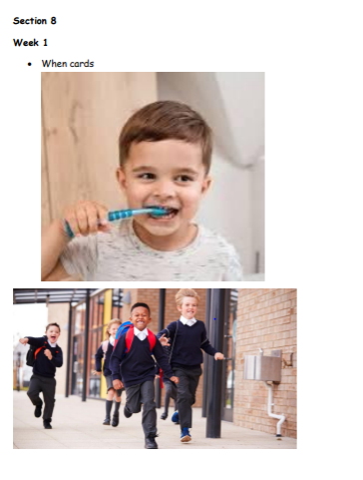
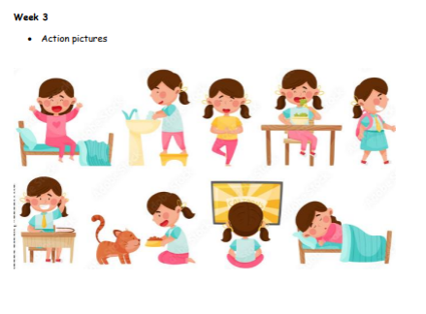
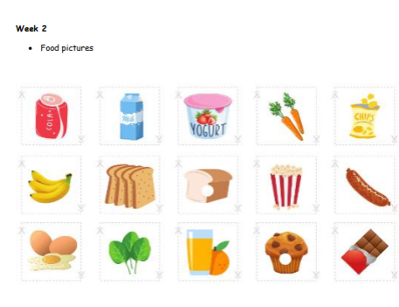
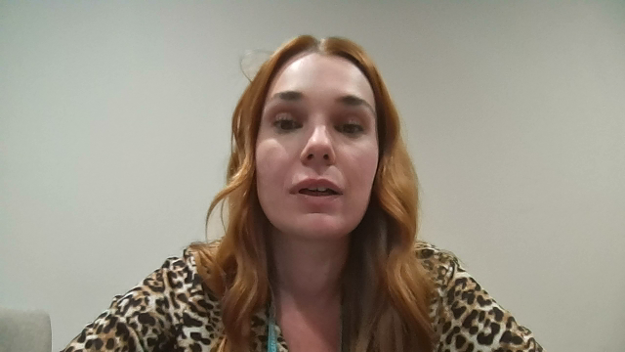
Notes:
We recommend you make packs of resources required for each section of WellComm so that it’s easy to ‘grab and go.’ We have made an appendix to help you with this with all the pictures you will need.

Slide 6
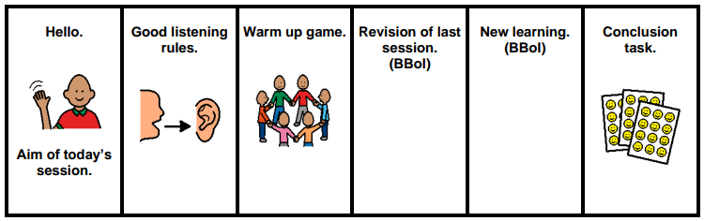
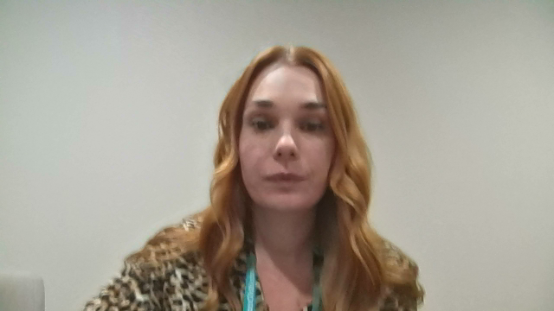
Notes:
Maintain a constant routine/structure of the session so that the children become familiar with this. You may consider using a visual timetable, such as this one.
Repeat activities as often as possible. Repetition will lead to faster progress. For an intervention to be effective remember the rule of 25 exposures, this may include exposures in groups/1:1 during targeted intervention AND within the classroom generalisation. Consistency and regularity is key. Consider what is manageable in your setting. For example-whether an intervention is delivered 3 times weekly for 15-20 minutes or 10 minutes daily followed up with classroom embedding.
Remember to use ‘Step Up’ or ‘Step Down’ activities, depending on the children’s levels of understanding. We also recommend that you take 10 minutes at the end of each session so that you can plan for your next session whilst it is still fresh in your mind, and you can also accurately evaluate progress. We suggest you use simple recording methods on planning sheets, e.g. colour coding - red/amber/green or you could use something like beginning/Developing/Secure, so that you can easily refer back to which children need to embed skills further. Remember to share results with other key staff so that everyone is aware of the children’s language levels and current goals.

Slide 7
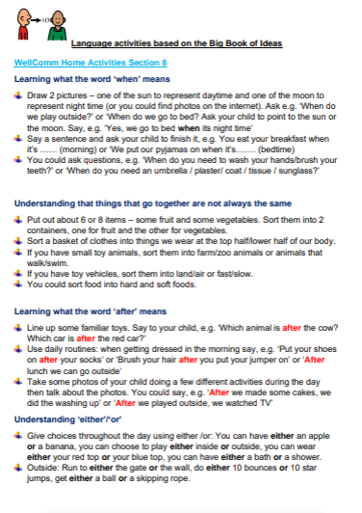
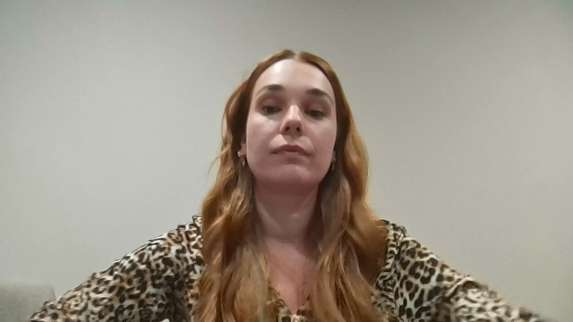
Notes:
Don’t forget you should involve parents and carers as much as possible so they can carry out activities at home too.
The home activity toolkit which has been devised by the ELSEC team can help support this too

