Slide 1
SEND in a Nutshell
June 2025

Slide 2
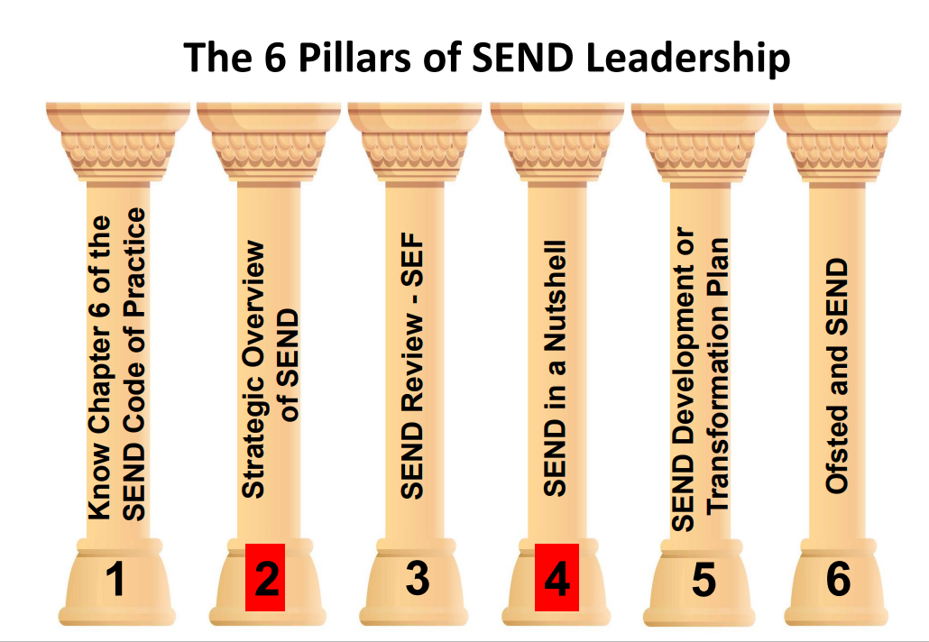
SEND in a Nutshell – why?
Taken from Malcolm Reeve’s Whole-School SEND Webinar, Nov 21

Slide 3
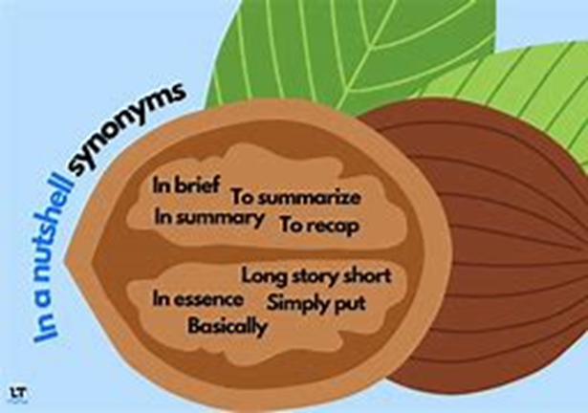
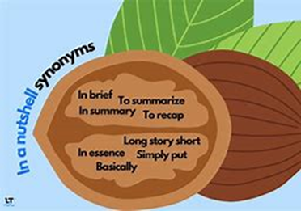
SEND in a Nutshell – Why?
Provides clear, concise school info in relation to local and national stats
Supports understanding of school’s SEND context for wider stakeholders
Helps to raise profile of SEND within the school
Initiates reflection and discussion on differences/changes
Supports whole-school, strategic development planning

Slide 4
SEND in a Nutshell – How?
One (or Two) Page Profile
Identify key info to be presented
Half-termly/ Termly Updates
Update the Nutshell data either half-termly or termly, in line with Census data collection (Oct, Jan and May)
Liaise with other Leads & Share
Liaise with Attendance & Pastoral Leads for shared data
Ensure school central record data matches Nutshell data
Visuals are helpful, alongside data tables
Share updated SEND in Nutshell doc widely with all leaders & key stakeholders
Display in central location in school

Slide 5
SEND in a Nutshell – What?
SEND Stats
Present all data across All SEND, SENS & EHCP School, local and national SEND & Gender SEND & Cohorts Broad Areas of Need Monitoring List & EHCNAs
Attendance, Exclusions & Outcomes
Present all data across All SEND, SENS & EHCP Attendance Exclusions Outcomes Destinations
HQT & Interventions
List top 3-5 HQT strategies List main interventions across broad areas of need & Key Stages
Strengths & Actions
List top 3-5 strengths of SEND provision Add in Key Actions for academic year

Slide 6
SEND in a Nutshell – SEND Stats

Slide 7
SEND in a Nutshell – SEND Stats
Based on primary needs | All SEND % |  |  | SEN SUPPORT % |  |  | EHCP %
 | Sch | Loc | Nat | Sch | Loc | Nat | Sch | Loc | Nat
Cognition & Learning (C&L) |  | 18.6 | 26.3 |  | 20.1 | 28.1 |  | 15.8 | 21.7
Communication & Interaction (C&I) |  | 51.1 | 40.6 |  | 46.0 | 35.4 |  | 60.4 | 54.3
Social Emotional & Mental Health (SEMH) |  | 18.9 | 21.6 |  | 21.1 | 23.6 |  | 14.9 | 16.0
Sensory & Physical (S&P) |  | 6.4 | 4.8 |  | 5.3 | 4.3 |  | 7.9 | 6.0
Notes:
High number of other disability/no specialist assessment nationally and locally
450 pupils in Oldham whose primary needs are unclear.

Slide 8
SEND Stats-Reflections
What are your current SEND stats?
Where do your SEND stats sit against national and local data- lower, higher, in line?
What do you think the reasons are for any differences?
Are there any changes to primary needs or cohort needs?
Are there any whole-school changes that could be made to respond to changing pupil needs?

Slide 9
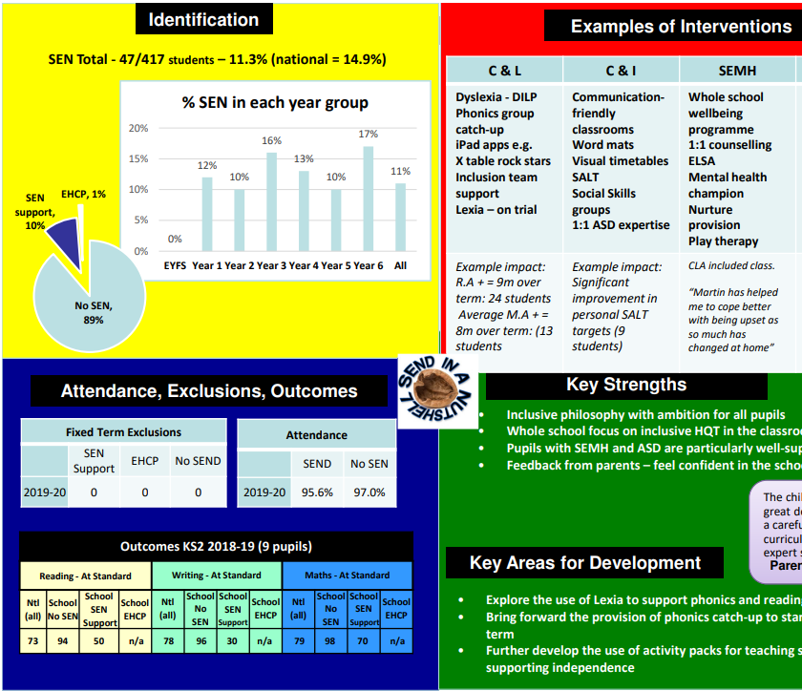
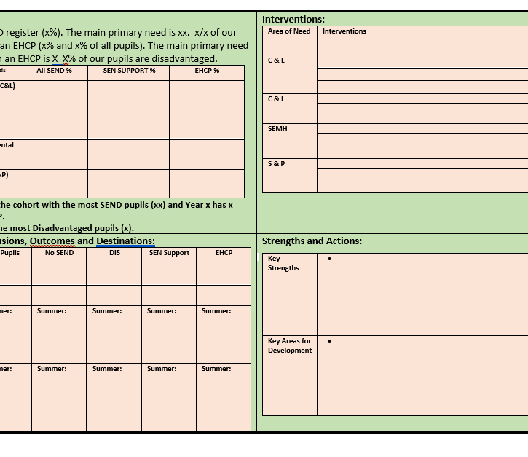
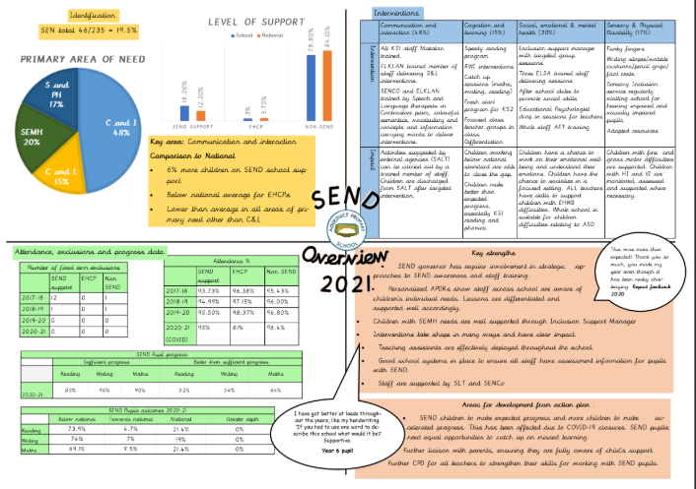
SEND in a Nutshell Templates

Slide 10
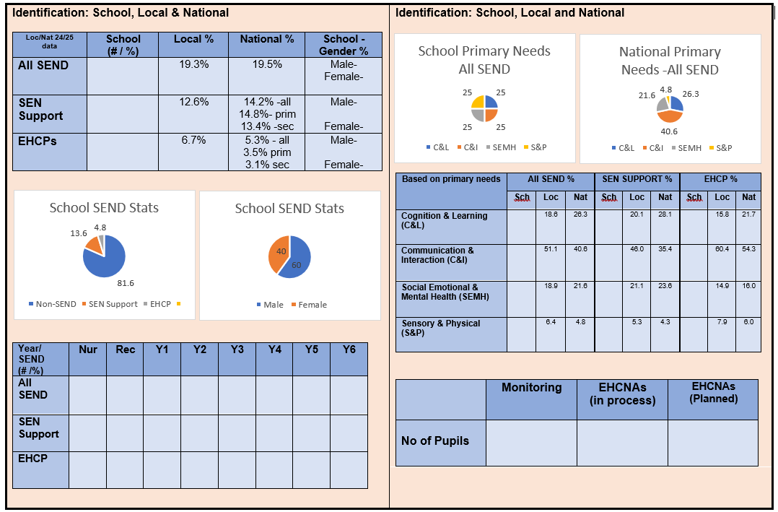
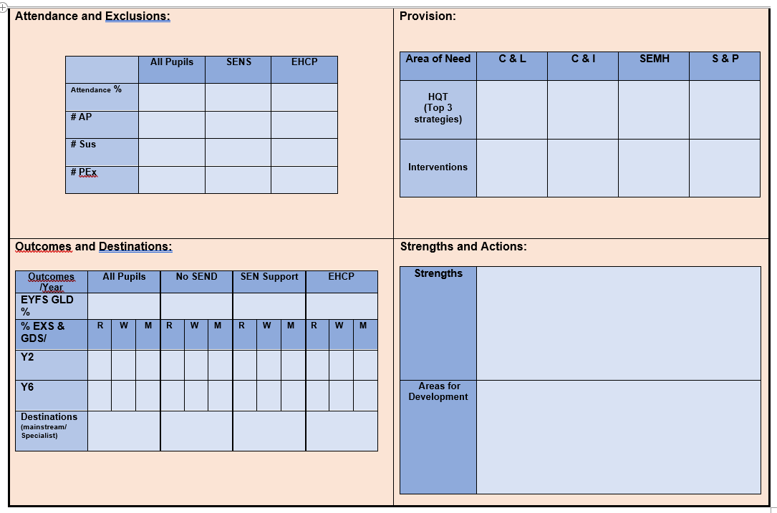
Oldham Template- Primary

Slide 11
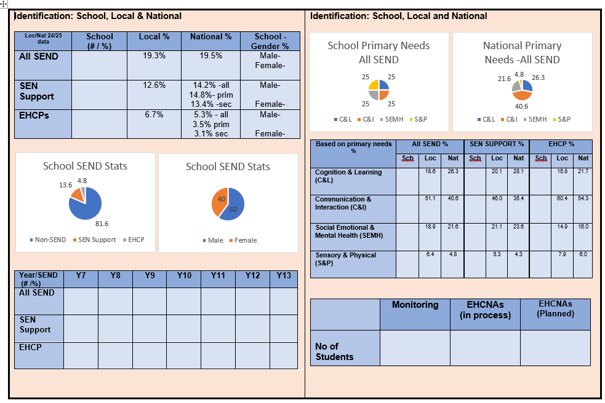
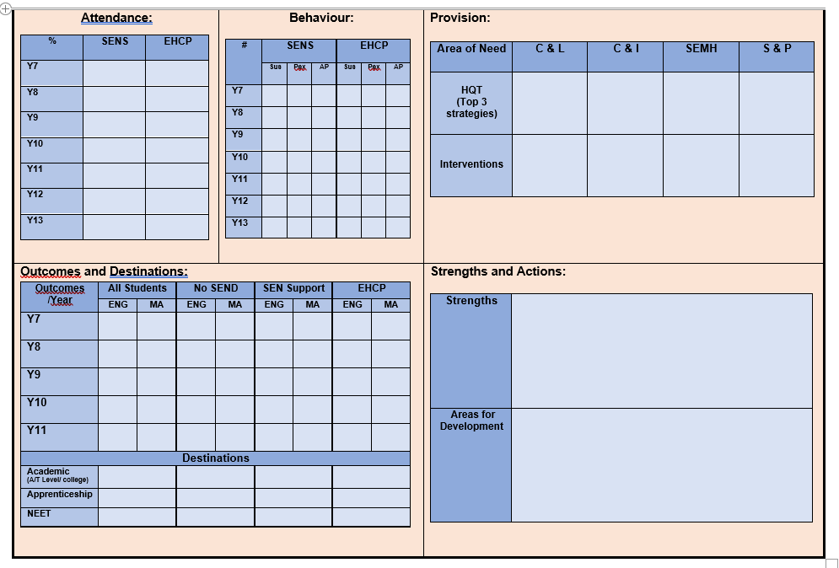
Oldham Template- Secondary
Notes:
Templates will be updated annually with national and local SEND stats and uploaded to SENCo Space for you to access.

Slide 12
Contact
Sharon Meacock
SEND Improvement Officer
Sharon.Meacock@oldham.gov.uk
OSSS.SENDReviews@oldham.gov.uk
Mobile: 07483 320940

