Slide 1

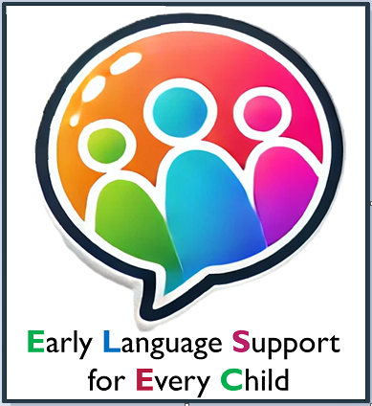
How to use the toolkit with EAL children
Delivered by: The ELSEC Team
Notes:
WellComm is a screening toolkit providing a profile of strengths and areas of need based on English language developmental norms.
This means there are a few things we must be mindful of when using and interpreting WellComm with children who are multilingual and where English may be their second, third or even fourth language.
Firstly: we need to be aware of all the languages the child is exposed to. It is important to speak to parents and find out what languages are spoken at home, what languages are important for their child to learn and if they have any concerns or worries about their child’s language development in their home language. It is important to make observations, discuss with family and explore a child’s skills holistically to gain a more accurate picture.
Secondly: when screening a multilingual child: If screening in English this will give you an insight into the child’s developing English language development. If you are delivering the assessment in a language other than English it is important to be aware that some tested items may not translate directly into other languages.
Different languages have different rules and so typical developmental norms will vary, for example use of gender specific pronouns (like he/she etc) may exist in English but in some languages they do not, OR, information carrying words or key word levels in an instruction or sentence if given in English may not be the same as if the sentence was given in another language.
Additionally the vocabulary someone is exposed to can be culturally influenced and things like idioms such as ‘it’s raining cats and dogs’ or ‘under the weather’ are culturally bound expressions which when translated may not carry the same meaning. This is why it is important to gather information about the child’s home language skills through discussion with family.
If you do plan on translating WellComm, you may have staff that speak the child’s home language or you may want to source an external interpreter. It is not recommended to ask family members to translate for you.

Slide 2

May be difficult to assess skills in home language. Structure of sentences differ between languages.
Can be translated into Punjabi, Urdu, Gujurati and Bengali up to Section 5
Can be translated into Polish, Latvian and Bulgarian up to Section 3
Liaise with a native speaker of a language to see if it can translate.
Notes:
Can be translated into Punjabi, Urdu, Gujurati and Bengali up to Section 5
Can be translated into Polish, Latvian and Bulgarian up to Section 3
Interpreting WellComm:
It is helpful to be aware that children may not always respond in the same language they are assessed in and may use a mixture of their languages for example you may assess and ask them the questions in Urdu but they may respond in English or vice versa, this is fine and a typical part of being multilingual.
When interpreting WellComm scores, if the WellComm has been delivered in English, this will give a profile of that child’s progress with their English language development and an insight into their readiness to learn language. If translated, not all items will translate, typical developmental norms are not the same across languages and therefore not all items can be scored.
Therefore, in summary, when used with multilingual children the WellComm can still support in providing a profile of a child’s English language skills and the child’s capacity to learn language however we must be mindful of the differences in languages and that it may not be a precise representation of ALL their language skills.
Finally - multilingualism is an asset and provides a multitude of opportunities, parents should be encouraged to speak the languages they are most confident and comfortable in and provide plenty of opportunities for their child to hear and interact with them.

