Slide 1

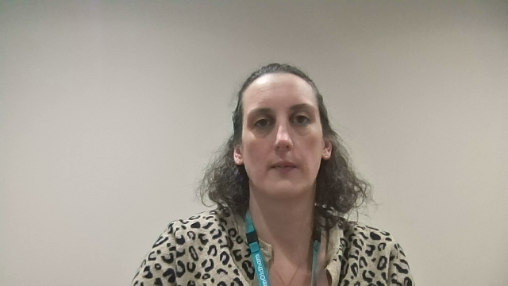
How to do the Primary screening
Delivered by: The ELSEC Team
Notes:
Every child in EY should be screened using the Early Years WellComm. Children who don’t achieve a green score at their chronological age band should access regular intervention and be re-screened termly to track progress. Beyond this it is recommended that children should be screened with WellComm at any point, either EY or Primary, if concerns around language or communication are raised. You may also want to screen children who are new to school where little information has been provided about them. However, please note it is always important to give children time to settle.

Slide 2
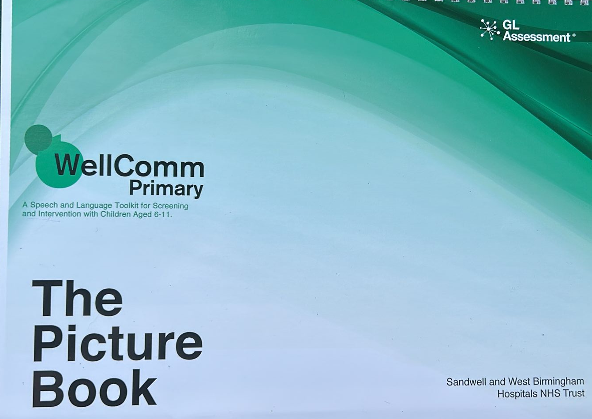
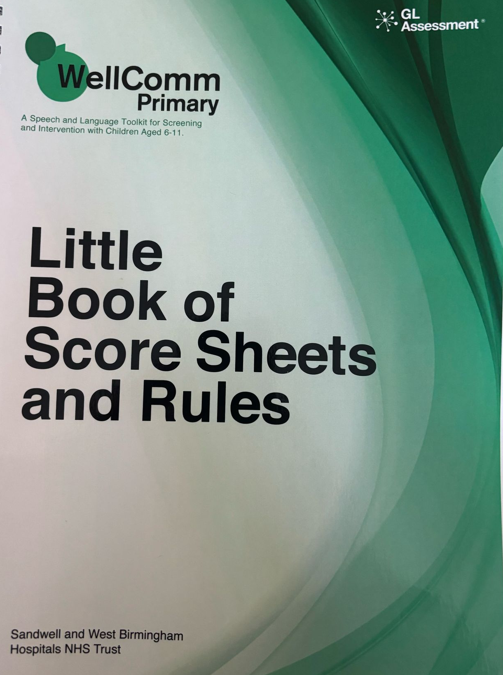
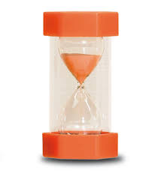
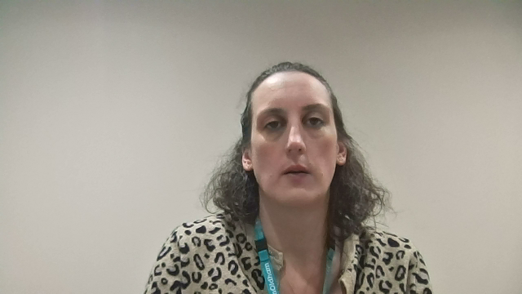
Notes:
To complete the WellComm Primary screen you will need: The picture book and the Little Book of Score Sheets and Rules and some photocopies of the score sheets as you will need to write on these! The only additional resource needed for the WellComm primary is a timer. It is a good idea to find a quiet space to complete the screening, with minimal distraction.

Slide 3
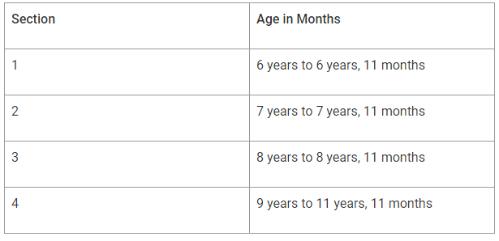
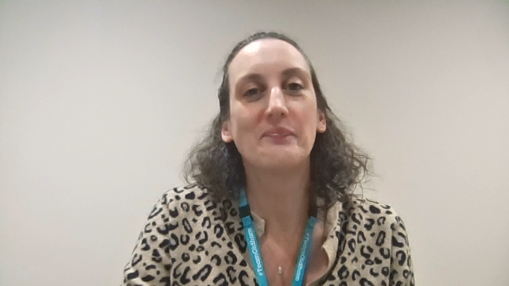
WellComm Primary sections
Notes:
Start by looking at the WellComm age guide at the front of the Little Book of Score Sheets and Rules. Consider the age of the child in front of you and note the relevant section to start them at.

Slide 4
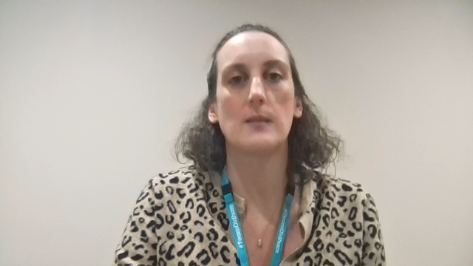
WellComm Primary sections
Notes:
For example, if you have a child in front of you who is 7 years and 6 months, you will start assessing them at section 2.

Slide 5
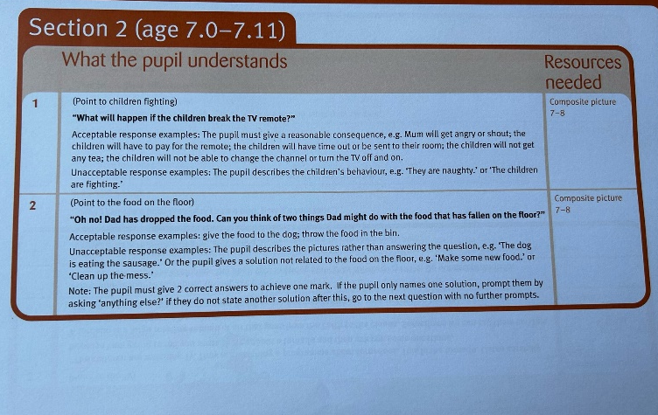
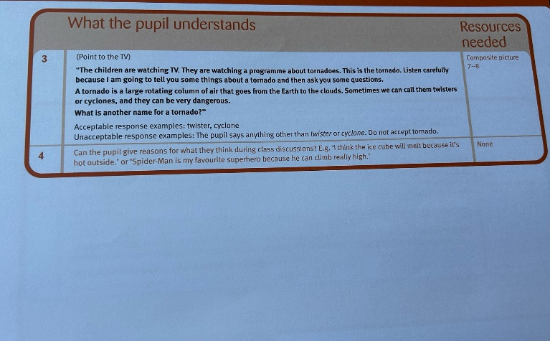
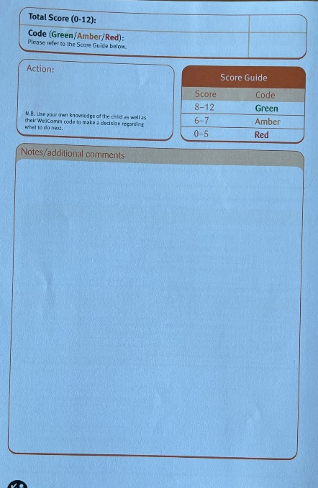
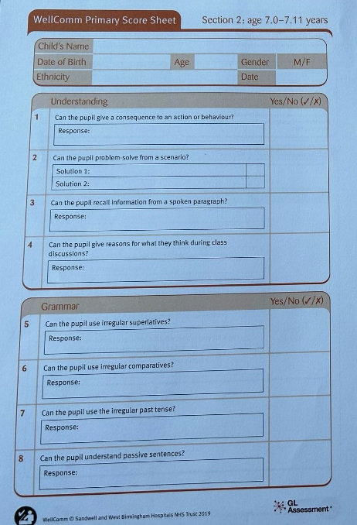

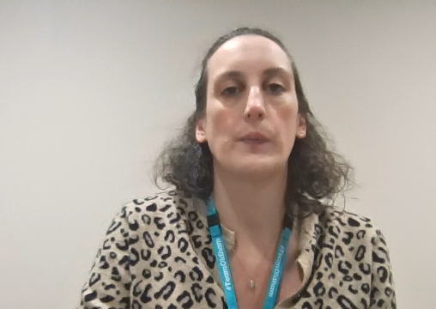
Rules
Score sheets
Notes:
Now that you know which section you are going to start assessing the child at, find that section in your photocopied score sheets. Then find the same section in the ‘rules’ part of the Little Book of Score Sheets and Rules. For example, if you are assessing them at section 2, you would find section 2 in the rules. This will be your script. Read each question to the child, showing them the relevant picture from the Picture Book. Be careful not to give anything away when you are asking the questions. Mark on the score sheet whether they get the answer right or wrong (consider using a tick with a hook instead of a cross if the child answers incorrectly). If the font in the Rules is the same colour as the section, this is an observation and should not be read aloud. There is room at the end of the score sheet to add any notes or additional comments. For example, if the child’s speech is unclear or they have poor attention.

Slide 6

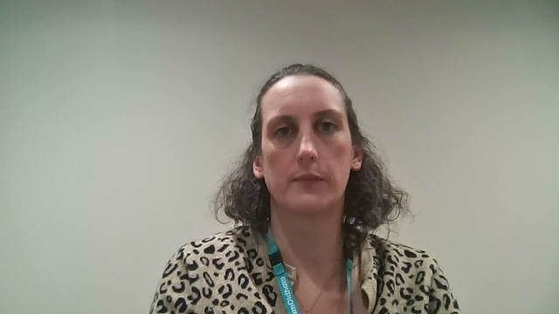
Notes:
When you have completed all the questions with the child in that section, total up the number of questions the child got right and look at the score guide to determine a red, amber or green AKA RAG score. If the child scored green, there is nothing more you need to do – that child is working at that age equivalent. If the child scored amber or red, you would need to continue to screen backwards to find their baseline. For example, if the child was assessed at section 2, but they scored amber, you would need to do the assessment at section 1. Keep working back until that child achieves a green. For some children, this might mean needing to go back to the early years WellComm assessment.
Please note, the assessments can be broken up into chunks or done over a series of days if the child is struggling to focus. Consider using now and next boards if needed.

Slide 7
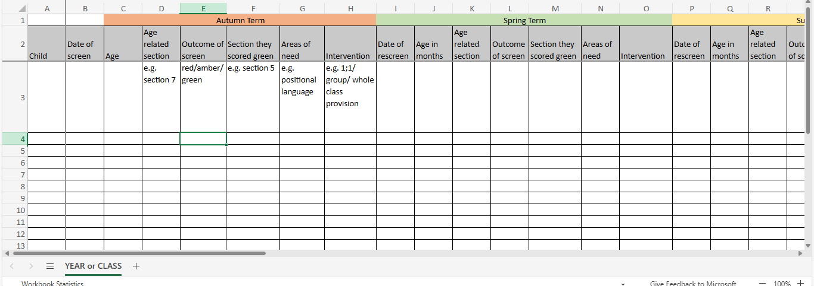

Notes:
You should ensure scores/baselines are recorded, you may use a spreadsheet or WellComm Digital/Wizard for this. You will need to do this to track children’s progress over time and to monitor it this is working for them, it will also help with setting up intervention groups and knowing which sections are a high priority to focus on in the classroom if there are higher numbers of children at a particular area.

