Slide 1
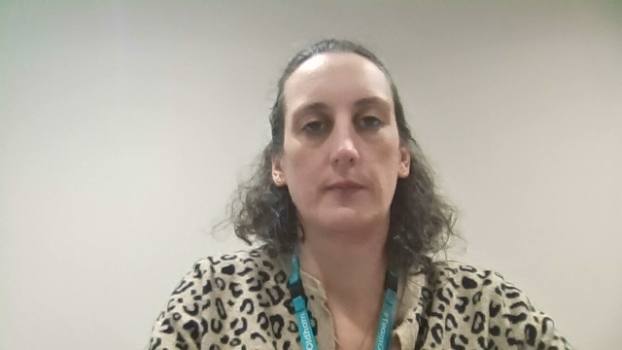

How to do the Early Years screening
Delivered by: The ELSEC Team
Notes:
In Oldham, Local Authority teams advise that every child is screened using WellComm in their first term at reception.
It is recommended that all children are screened on entry in early years. This will provide you with a baseline for that child’s language skills.

Slide 2

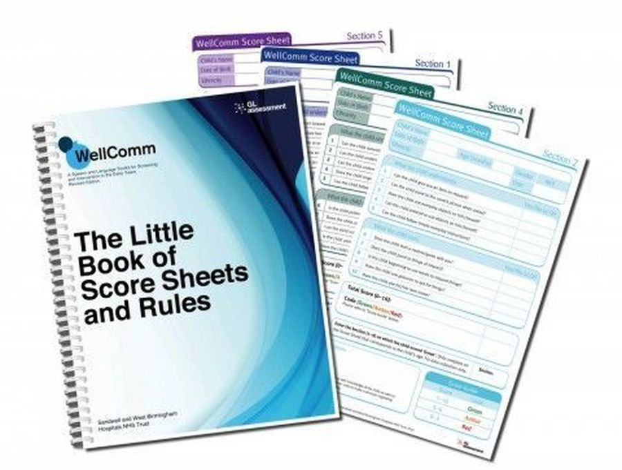
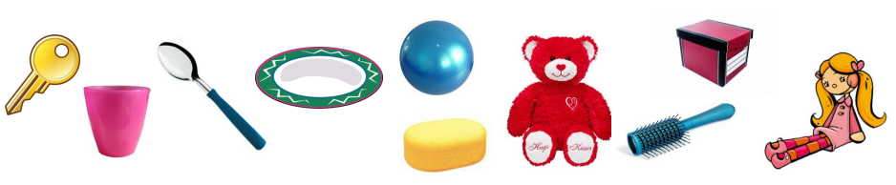
Notes:
To screen you will need: The picture book and the Little Book of Score Sheets and Rules and some photocopies of the score sheets as you will need to write on these!
You will also need to gather up the resources required, to administer the screening. (For Early Years, you will need: a key, a cup, a spoon, a plate, a ball, a sponge/flannel, a teddy, a box and a doll). It is a good idea to keep these in a box so that whenever you need to do an assessment, everything is ready to go. If possible, try to find a quiet space to complete the screening, with minimal distraction.

Slide 3
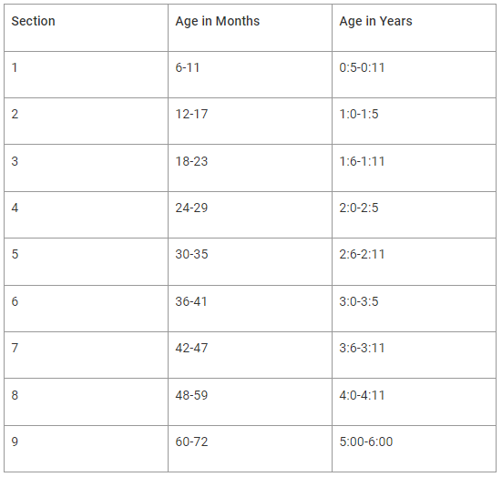
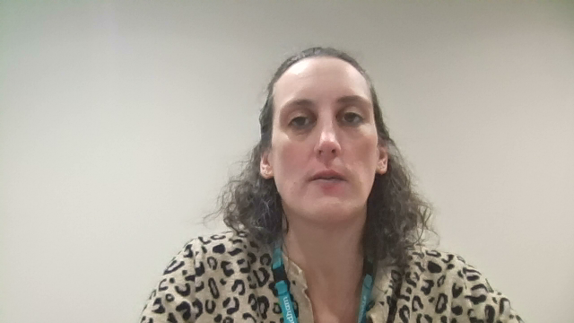
WellComm Early Years sections
Primary
Notes:
Start by looking at the WellComm age guide at the front of the ‘Little Book of Score Sheets and Rules’. Consider the age of the child in front of you (you can work this out in either years or months) and note the relevant section to start them at.

Slide 4
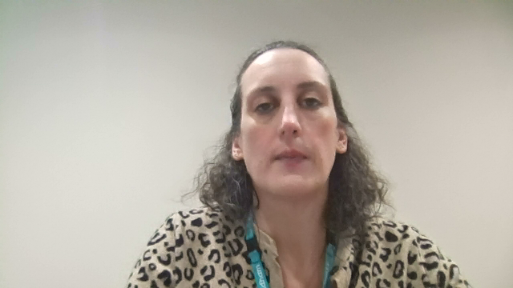
WellComm Early Years sections
Notes:
For example, if you have a child in front of you who is 4 years and 6 months, you will start assessing them at section 8.

Slide 5
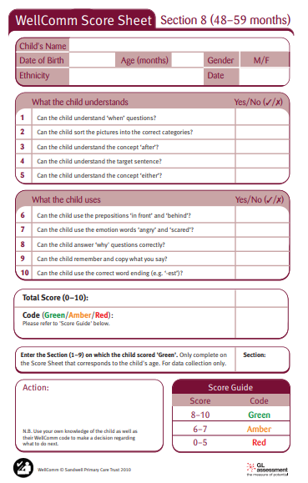
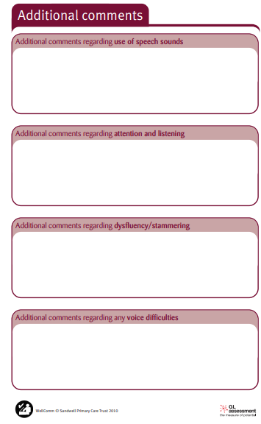
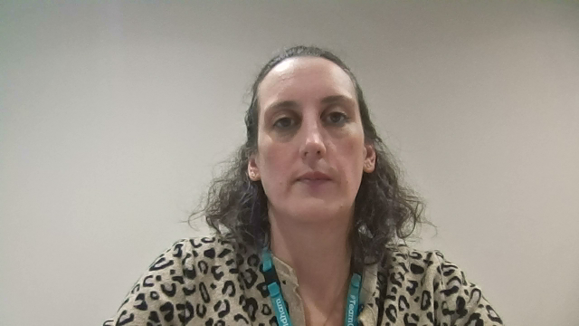
Notes:
Now that you know which section you are going to start assessing the child at, find that section in your photocopied score sheets. Then find the same section in the ‘rules’ part of the ‘Little Book of Score Sheets and Rules’. For example, if you are assessing them at section 8, you would find section 8 in the rules. This will be your script. Read each question to the child, showing them the relevant picture from the Picture Book and, if needed, the resources listed. Be careful not to give anything away when you are asking the questions. Mark on the score sheet whether they get the answer right or wrong (consider using a tick with a hook instead of a cross if the child answers incorrectly). If the font in the Rules is the same colour as the section, this is an observation and should not be read aloud. There is room at the end of the score sheet to add any notes or additional comments. For example, if the child has unclear speech or poor attention.
When you have completed all the questions with the child in that section, total up the number of questions the child got right and look in the score guide to determine a red, amber or green AKA RAG score.

Slide 6
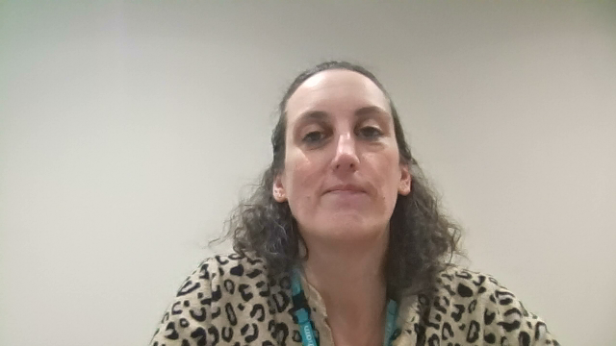
Notes:
If the child scored green, there is nothing more you need to do – that child is working at that age equivalent. If the child scored amber or red, you would need to continue to screen backwards to find their baseline. For example, if the child was assessed at section 8, but they scored amber, you would need to do the assessment at section 7. Keep working back until that child achieves a green.
Please note, the assessments can be broken up into chunks or done over a series of days if the child is struggling to focus. Consider using now and next boards if needed.

Slide 7
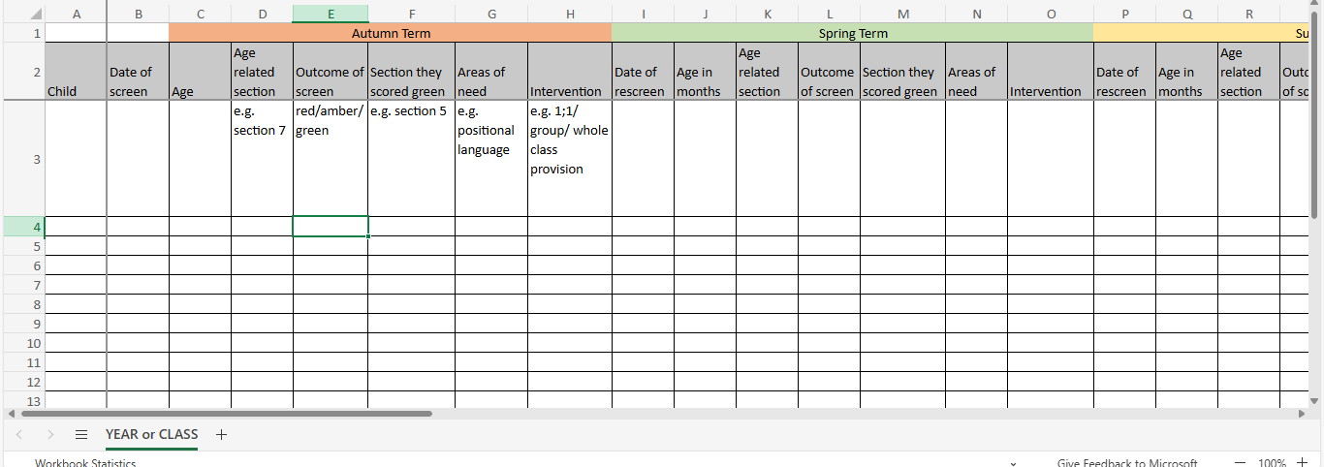
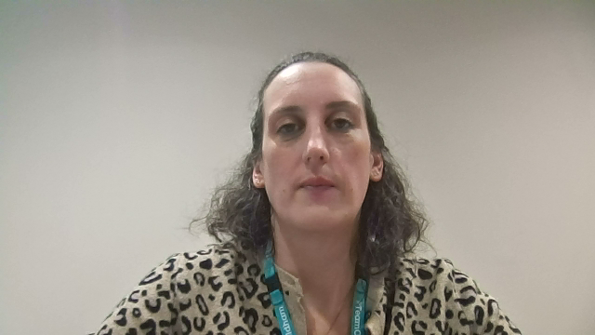
Notes:
You should ensure scores/baselines are recorded, you may wish to use a spreadsheet or WellComm Digital/Wizard for this. You will need to do this to track children’s progress over time and to monitor if the interventions are working for them. It will also help with setting up intervention groups and knowing which sections are a high priority to focus on in the classroom if there are higher numbers of children with gaps in a particular area.
Children who did not achieve green at their age-appropriate level should be rescreened termly, after having completed all the interventions in the section they’ve been working on. It is recommended to screen at the child’s chronological age as before. However please use your professional judgement if they have been working multiple sections/bands behind. You may want to start at a band closer to where they have been working at. Please note if they score green at this point but below their age equivalent band you may need to screen upwards towards their chronological age to check they haven’t made more than one band progress.

