Slide 1
Action Together – Social Prescribing

Slide 2




Social Prescribing
Community-Led Health and Wellbeing

Slide 3
Social Prescribing Day
19th March 2025

Slide 4
What is Social Prescribing?
Social Prescribing is delivered through a consortium of Local Early intervention and prevention organizations
Positive Steps
Age UK
Tameside, Oldham and Glossop Mind
Together we support people across Oldham to identify and access activities, groups and services in their community that can meet their practical, social and emotional needs that affect their health and wellbeing

Slide 5
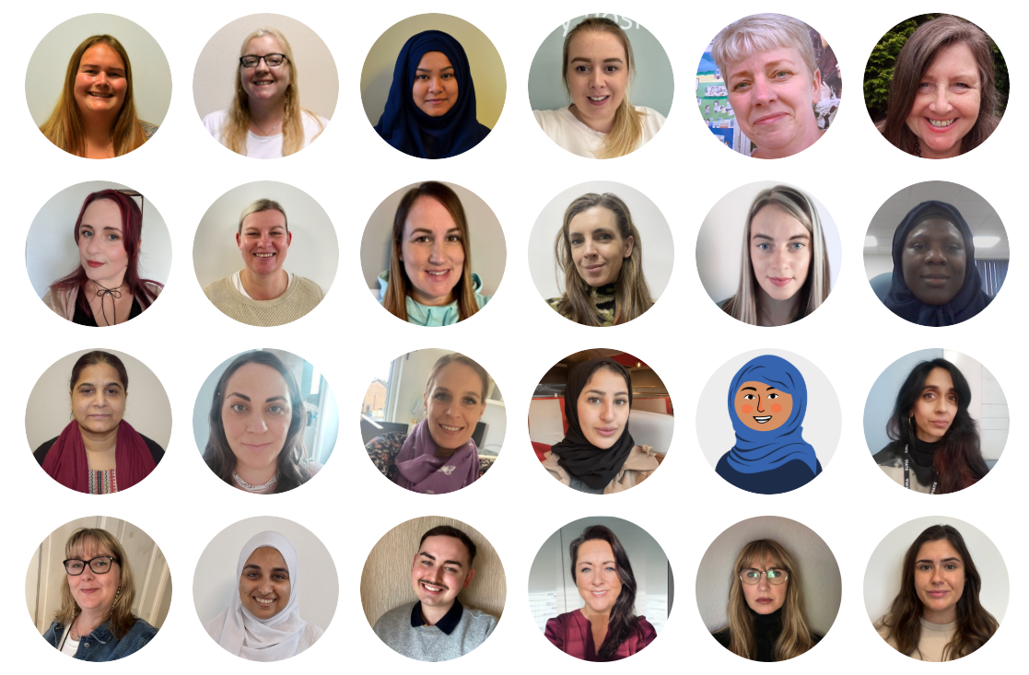
Social Prescribing Team
Social Prescribing Manager
Social Prescribing Coordinator
Triage and Administration
Genetic Social Prescribing
- 13 FTE split between 15 Link Workers
Older Adults Social Prescribing – 1.5 FTE
Work Well – 1 FTE Link Worker
Children and Young People Social Prescribing – 2 FTE
ARCC Social Care Front Door – 1FTE

Slide 6
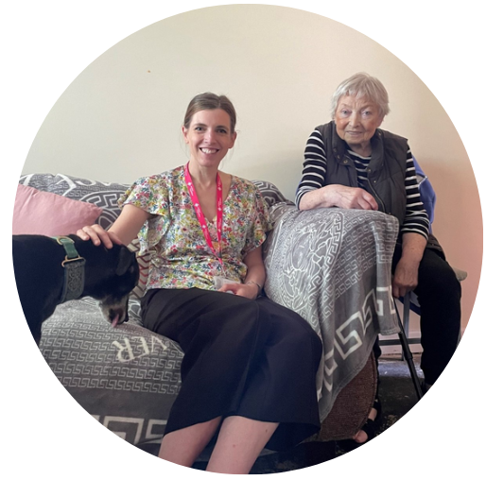
Social Prescribing in Practice
Referral Received
Triage
Weekly Allocation
Link Worker makes contact
First Appointment Arranged – Home, Community or office
Individual Wellbeing Plan is started through strength-based conversations and a holistic approach
Individuals journey through SP starts –
Outcome measures taken at 3 and 6 months

Slide 7
CYP and families Social Prescribing
Supported 209 families/young people since the CYP offer
Main reason for referrals is loneliness/isolation in young people.
Social prescribing links young people to activities in the community to improve mental health and wellbeing.
Support for parents/carers with SEN, school support, mental health, community groups/activities/signposting to HAF/VCS

Slide 8
Social Prescribing – evidence
There is now clear evidence that social prescribing works. Connecting people to groups, services and activities in their communities, based on what matters to them, and addressing underlying social factors, including loneliness, isolation or problems with debt or housing, has been shown to improve people's wellbeing and reduce demand for health and care services.
The National Academy for Social Prescribing report, The Impact of Social Prescribing on Health Service Use and Costs: Examples of local evaluations in practice highlights the evidence that social prescribing services can lead to substantial reductions in avoidable GP appointments, hospital admissions and A&E attendances.
The report builds on an existing body of evidence that social prescribing directly improves people’s health, strengthens communities and offers value for money. This highlights a 42.2% reduction in GP appointments among 1,751 patients who accessed social prescribing in Tameside and Glossop.

Slide 9
Last Year in Number
3,051 Referrals
  35% for loneliness and isolation
  40% for Mental Health, Depression/Anxiety
  20% Housing
31,886 Contacts with clients or other professional on behalf of client
1,953 Social Prescriptions

Slide 10
This Year in Numbers so Far – April to Jan 24
2,054 Referrals
  35% for loneliness and isolation
  40% for Mental Health, Depression/Anxiety
  23% Housing
27,452 Contacts with clients or other professional on behalf of patients
1,776 Social Prescriptions
546 Activities, services and organisations listed on Elemental

Slide 11
CYP feedback parents/professionals
Excellent support from Sarah Shaw. Contact with both family and school. Support above and beyond. Cannot stress enough what an excellent service Social Prescribing is and have recommended to the other Pastoral Teams in school.
My worker Sarah has helped me so much with my move and helped me with things I didn’t even know were available. Thanks Again
I would like to say a big thank you to Juwaria. She is brilliant at her job. So supportive and understanding and also meets your needs to the best she can. I wouldn't have been able to accomplish or do anything without her support . She has been amazing and an inspiration to others. So grateful for her help she has provided me with

Slide 12

How to Refer
Elemental – Emis or Portal
Email - gmicb-old.socialprescribing@nhs.net
Duty – 0161 339 2345, then Option 1
Case Meeting/MDT’s
Self-Referral link on the website
- https://www.actiontogether.org.uk/oldham-social-prescribing

Slide 13

Questions
Becky Kershaw
Social Prescribing Manger
0161 3392345/07595 180880
Rebecca.Kershaw@actiontogether.org.uk

Slide 14


www.actiontogether.org.uk
WeActTogether
WeActTogether

