Slide 1
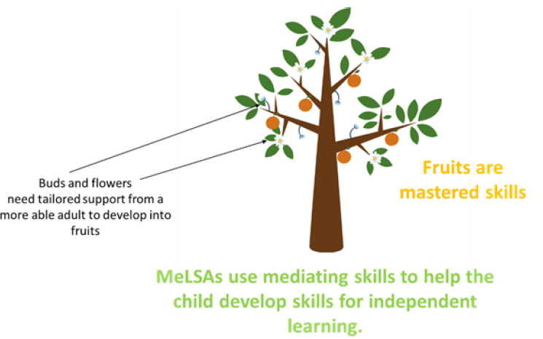

Mediated Learning Support
Approach, MeLSA
Oldham Educational and Child Psychology Service
Dr Elaine Ratheram, Debbie Burton
Notes:
Debbie

Slide 2
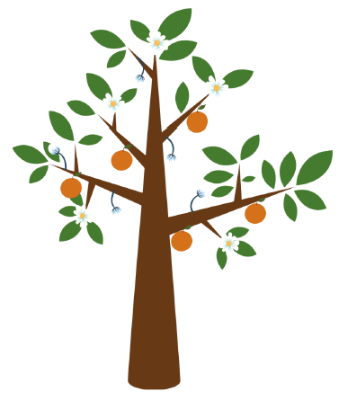
What is MeLSA (see handout)
A six day training and learning programme for staff that builds capacity of educational settings to support the learning needs of their children and young people (CYP).
MeLSAs learn about how CYP learn so that they can help them to learn.
MeLSAs gain the skills to assist CYP to be more skilled and independent learners using evidence-based research.
Notes:
Debbie
Key messages:
Want children to be independent learners – most children are – need to ensure all children are
Who?
Someone interested in learning and wanting to know ore
Good a building relationships with cs and working with others

Slide 3
Benefits of MeLSA
MeLSAs will have a better understanding of how to support CYP’s learning.
MeLSAs will offer more informed support to learners at one to one, small group and whole class levels.
MeLSAs will be able to share their skills with other staff.
MeLSAs will be able to monitor progress of the CYP they work with.
MeLSA is an intervention to support CYP to become independent learners.
Notes:
Debbie

Slide 4
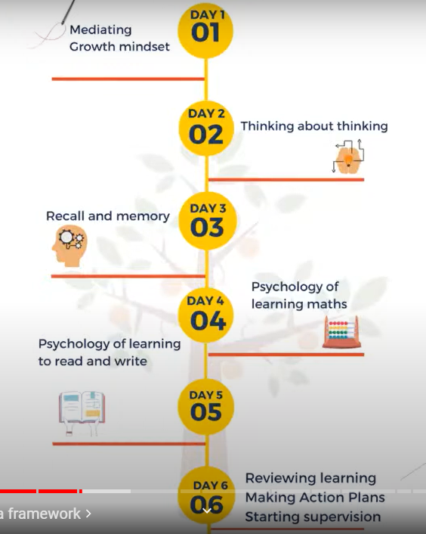
Cognitive load
https://edpsy.org.uk/blog/2022/mediated-learning-video-series/
Notes:
Elaine
So, Debbie has given you an overview of what MeLSA is and how it can benefit children and young people in our schools. What I'm going to now is give you a bit more detail. I should add at this point that MeLSA stands for mediated learning approach, rather than learning assistant, because the course in Bristol has been delivered in a variety of settings, eg to TAs., to whole school teaching staff, and to senior managers across schools who wanted to make systemic changes in their schools.
As mentioned earlier the entire concept and design of the course of MeLSA has come from Bristol educational child psychology service. The content came firstly from EPs analysing their own work and identifying common themes in their work around learning: thinking about what do we want adults who support children with that learning to know? The content was also informed by questionnaires that were sent out to sencos with questions like ‘what do you want your TAs to know? And questionnaires to TAs again ‘what would you like to know around learning and supporting children with their learning?’
3.
First 3 days, learning theories that will help TAs understand how to help CYP to become independent learners with a real focus on theory and practice of mediating and mindset, which are two threads that run right through the training.
There is a strong focus on the psychology of learning, as you would probably expect, for example we look at Vygotsky and the zone of proximal development; Feuerstein - mediating, what we are learning, why – meaning, where – transferring learning to other areas;
It includes a lot of work and concepts that I was more familiar with when I was doing my psychology degree and my EP training and maybe has dropped off my radar a bit. One of our approaches to preparing for delivering this training is to meet every month to discuss each day's training content. So far we’ve had a month to read and familiarise ourselves with the content of day one and recently had our meeting to discuss it. and I am finding this incredibly beneficial to my own understanding about learning and different ways that we can support people with their learning. I'm finding that it's already influencing my own practice. So for example part of this first session looks at the different levels of mediation what I’ve now started to do when supporting our first year trainee EP is rather than telling her how I would approach a new piece of work she is about to do and give her examples from my previous practise which is going in at level 4 of mediating , I'm going in at level 1 where we try to get students to think about what they already know and how they can use that to help them in this new task. So for example I'm asking questions like ‘have you done anything like this before?’, ‘ can you think of a time when you've spoken to a parent or had a meeting with a parent/ teacher about a child?’ , ‘what helped in that situation?’ ‘can you think of any skills you used that you'll be able to use in this new task that you're about to do?’ So I’m starting from that level 1 and sometimes I'm finding that that's all I need. Sometimes I'm finding that there is a bit more level 2, or Level 3 or level 4 that needs to go in. But for me the important thing is that I am going in at level one I'm not assuming that more is needed at the start.
So, day one also includes work around mindsets that promote learning and how to foster these growth mindsets.
Day two focuses on the psychology of thinking and the thinking skills that we use to monitor, control and direct our learning, and
Day three we learn about multi-store memory including working memory, what may impact memory and recall in the classroom and how to support memory and recall in the classroom.
On day 4 we look at the psychology of learning maths, investigation skills, mediating maths interventions to support learners
On day 5 we look at the psychology of learning to read and write, Jonathan Solity’s work, and precision teaching, fluency and paired reading approaches. How to support a CYP in developing their reading, writing and spelling, and develop confidence in mediating these skills.
On the final day we review learning, action plan for next steps ideally with the MeLSA’s line manager, and start the supervision process.

Slide 5
Example activity for applying theory to practice:
Work in pairs.
One of you is the teacher, one the child.
The teacher can watch the video, and the child looks away.
Growth Mindset Paper Challenge – YouTube - Google Search
The teacher explains to the child what they have to do, then mediates the activity, starting with the lowest level of mediation.
You will need: one piece of paper, the model, an instruction sheet, guide to the levels of mediating and access to a pair of scissors.
Notes:
Elaine & Debbie
There is a lot of theory in the course as you would expect because of the focus on psychology of learning, and there are a lot of practical activities to help participants practise the skills we are considering and promoting, and apply the theory to the classroom.
QEST can choose to have a go at this activity.
Child in class has been asked to copy this drawing. How would you the adult support them?

Slide 6
Details
School commit to:
enabling the MeLSA participant to attend the entire 6-day training course
Attend on-going supervision;
Timetabling planning time for work with CYP
Autumn 2025
Cost around £600 including training, and supervision for the next two terms (£500 each for additional people from the same setting)
Open to anyone, especially those who are passionate about learning.
Notes:
Elaine

