Slide 1


Supporting International New Arrivals:
A good practice and resource guide

Slide 2

General Good Practice
A Welcoming Environment that supports belonging:
Organize a welcome event with a dedicated induction program, introducing the school, its culture, staff, and everyday routines (even details like fire alarms or assembly days etc)
Create a ‘welcome desk’ or a designated key adult that new arrivals can approach with any concerns, whether academic, social, or personal.
Create busy folders: Promote independence and reduce the anxiety that a newly arrived child may feel during unstructured time by giving them a bank of purposeful tasks/activities they can pick up and do. This is especially useful for promoting independence when they aren’t sure what to do and rely on adult guidance.
Nurture based morning check in sessions and calm corners in classrooms where possible - somewhere they can go to when it gets too much (Well-being check ins consistently throughout the day aswell!)

Slide 3
General Good Practice
Supporting development of relationships:
Encourage peer mentoring or buddy systems. Pair new arrivals with a student who speaks the same language. This can reduce anxiety and build a support network.
Promote Social Integration: Create opportunities for play and social interaction that uses limited verbal language skills to create a sense of belonging. E.g Tag, football etc – Pupil voice research highlighted the role developing friendships has in supporting integration in newly arrived students.
A relational approach – Pupil voice research found that new arrivals identified kindness from adults around them as key to supporting them to settle into their new school.

Slide 4
General Good Practice
Cultural Sensitivity:
Create a space where students feel their culture is respected and celebrated. Display multicultural artwork, signs, and information in multiple languages where possible.
Create opportunities for students to share own their cultural traditions, music, food, and stories with the school community to foster a sense of belonging. E.g a dedicated Culture Day
Make an effort to get to know their culture, language and previous experiences as some individuals hold their culture very close to their identity and the experience of a cultural shift when moving to a new country may feel like a loss of a part of their identity. One fun way to do this is to exchange a word of the day between you, in English and their home language so they are ‘teaching you’ and sharing their language with you.

Slide 5
General Good Practice
Supporting Family Engagement:
Engage with the families of international students through parent-teacher meetings, offering interpretation and translation services when necessary. This can be done via translation apps or identifying a member of staff that speaks the same language in the school and can translate.
Including lots of visuals for parents as well when sending home any written information.
Provide families with an introduction/welcome meeting that informs them about school policies, events, and ways to support their child’s education as they may not be familiar with the way the English education system works.

Slide 6
General Good Practice
Learning Support
Inclusive teaching strategies with interactive lessons, scaffolding and integrated practical/visual learning opportunities. This reduces any cognitive load required to learn the lesson content and decoding the language used.
Classroom integration: The classroom environment provides the experience of social and academic inclusion with access to people using English in different contexts, creating more valuable and rich learning experiences than 1-1 work separately with an adult.
Allow them time to adjust to a new educational system and styles of teaching. Lowering demands (especially language-based demands) in the initial stages of settling.
Clear, chunked down, step-by-step instructions for learning tasks with processing time where possible.
Consistency of visual prompts/aids so children can make links and process information without getting confused.
Regular Learning breaks

Slide 7
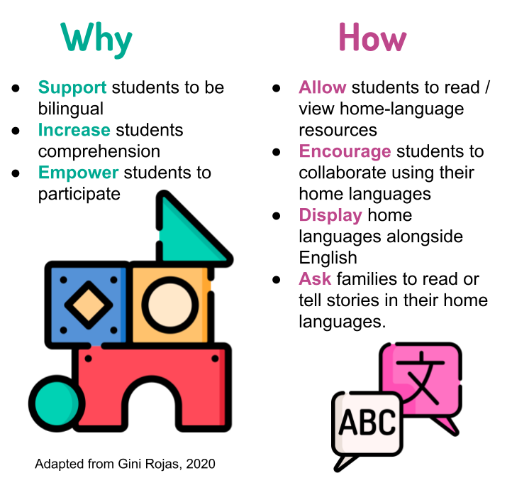
General Good Practice
Using a Translanguaging approach
Encourage children to speak, write and/or translate to and from their preferred language and English. Encouraging translanguaging involves fostering positive attitudes towards multilingualism. All EAL learners have useful language skills in their first language, and many also have literacy skills, which they can build on to acquire English. to English.
Learners may sometimes find it easier to engage with new concepts in their first language and transfer that knowledge and understanding

Slide 8
General Good Practice
Using a Translanguaging approach
Examples of a translanguaging approach in practise include using bilingual glossaries and words banks, allowing them to read /write in their preferred language first, use of subject specific books in their preferred language etc
We want to support English language development…. but also want to encourage the continuation of the home language. Research suggests children who are encouraged to use and develop their home languages achieve more highly than those whose first language and culture are not used/valued!
For more information and a detailed video guide see: Translanguaging - The Bell Foundation

Slide 9
General Good Practice
Language/communication Support:
Pre-teach Vocabulary using pictures, flashcards, or real-world objects to help children build language comprehension.
Simplify Texts and Resources and use consistent key words instead of long sentences. AI can be used to support this.
Extra processing and speaking time – newly arrived children identified that they have to go through many processes in their brains during interactions to interpret the English spoken to them and then translate into their language to understand, after which they form a response in their home language and translate to the equivalent English spoken words (during every interaction!)
Be mindful of the ‘silent period’ of newly arrived children: This is when they are actively processing the new language, listening and tuning into their new routine and environment. They may not produce much output at this stage, but they are not passive either! They are absorbing everything around them so be mindful of this and allow them to go through this at their own pace.

Slide 10
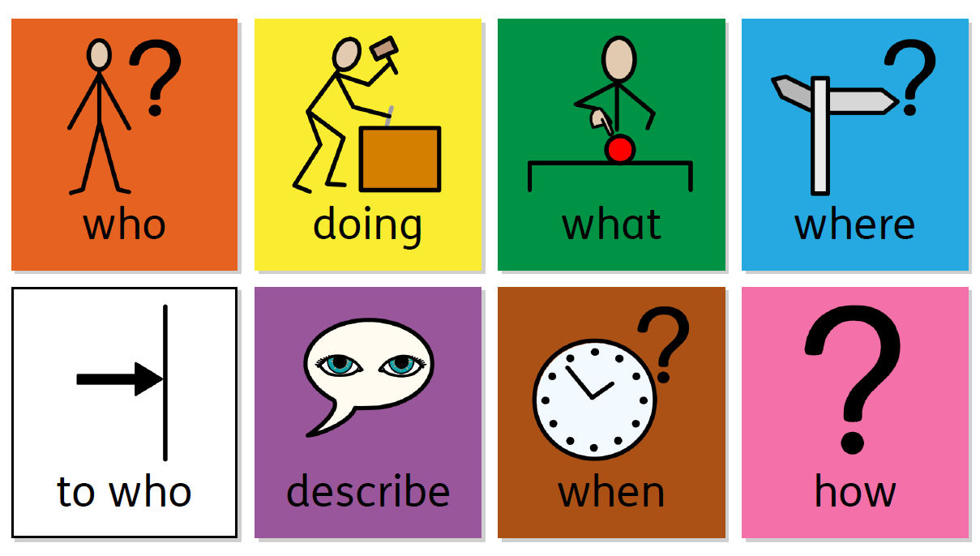
Resources
Colourful Semantics: support spoken and written language learning. It is a system for colour coding sentences according to the role of different words. It can help children to break down sentences and understand the individual meaning of each word and it’s role in the sentence.
See video linked below for examples of using colourful semantics:
https://youtu.be/mQtmY3oqf48?si=WHiPobqcL2wBOX6k
Notes:
https://www.structural-learning.com/post/colourful-semantics-a-teachers-guide

Slide 11
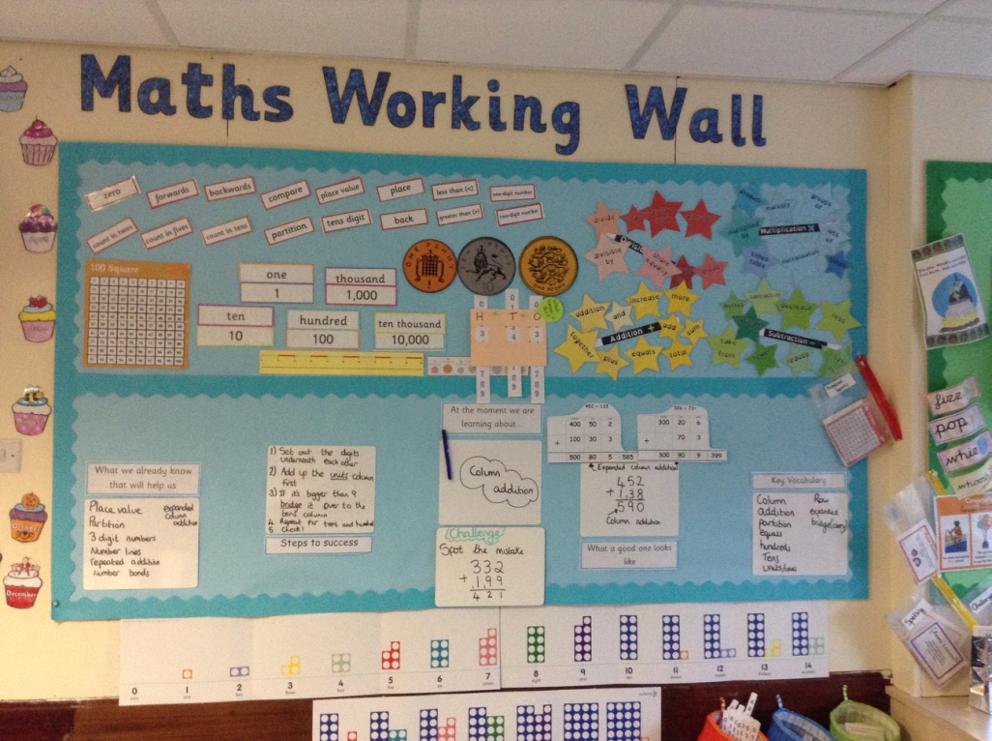
Resources
Working walls - an interactive display that includes key vocabulary, learning objectives, model examples to refer to and useful resources and scaffolding such as word banks and sentence starters.
https://literacywithmissp.com/2018/08/07/harnessing-the-power-of-working-walls/
Working Walls in Primary Classrooms Explained by PlanBee
Notes:
https://www.structural-learning.com/post/colourful-semantics-a-teachers-guide

Slide 12
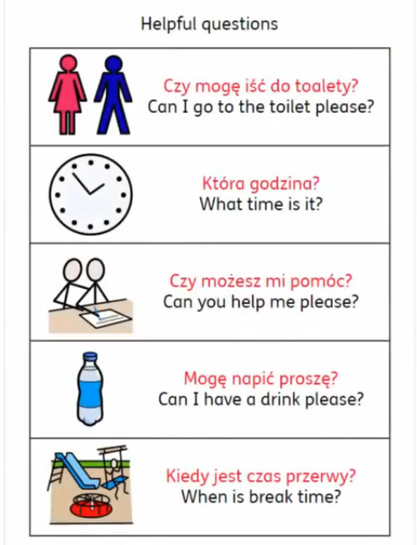
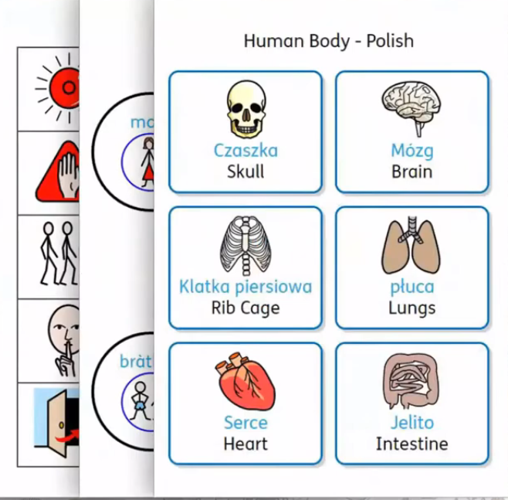
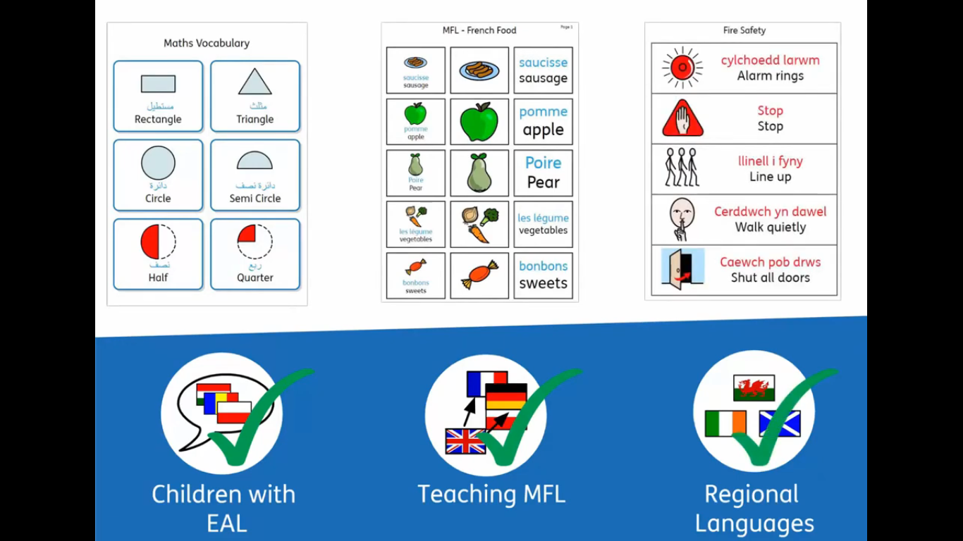
Resources
Widget: can be used for Communication InPrint and for lesson activities i.e to match words to their definitions. This can also be used to develop talking mats with text in different languages to allow for an easily accessible initial information gathering tool to identify areas the new arrival may require support. Has a Dual Language Feature pack that translates text to different languages.

Slide 13
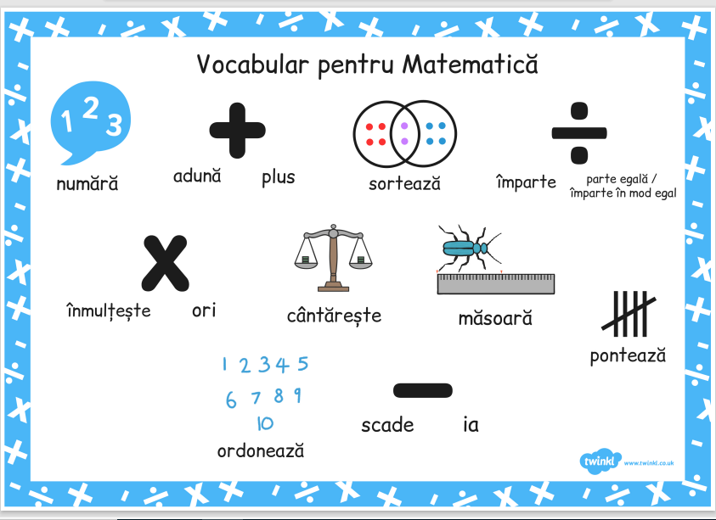
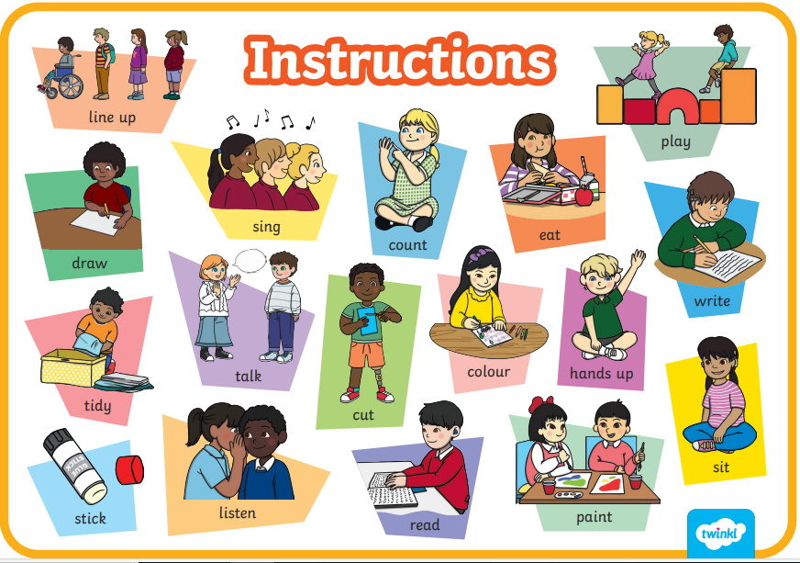
Resources
Twinkl: offers lot of resources for learning across the curriculum, including language development. This also includes word mats in different languages - See examples of Twinkl Word Mats above and click the link below to see examples of how these can be used to support EAL learners.
Supporting EAL Learners with Word Mats

Slide 14
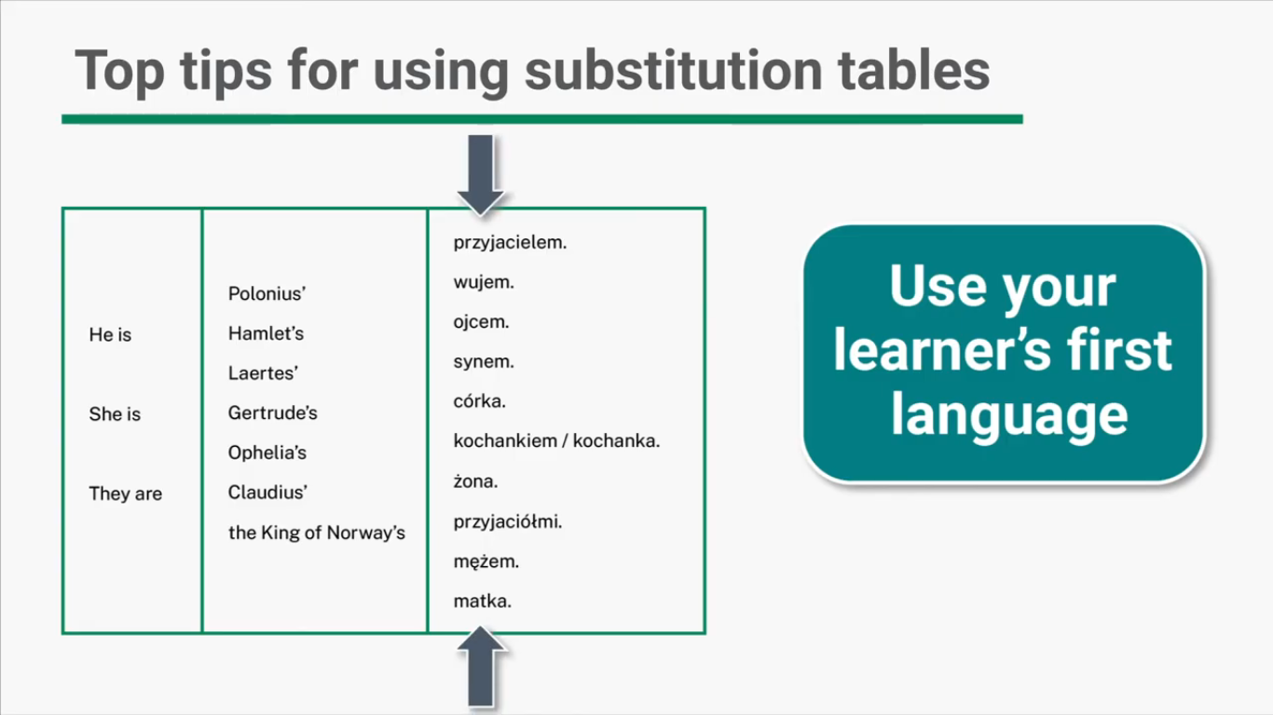
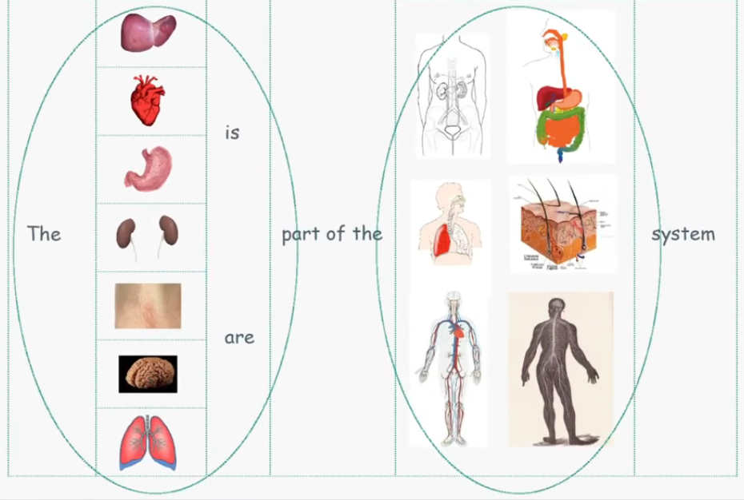
Substitution Tables: Provide a table giving model sentences with a range of choices to select from, using a set pattern. This is a useful scaffolding resource which can be used as a reinforcement of newly-acquired Language. This can also be done incorporating the learners first language.
Further information: Substitution Tables - The Bell Foundation
Resources

Slide 15
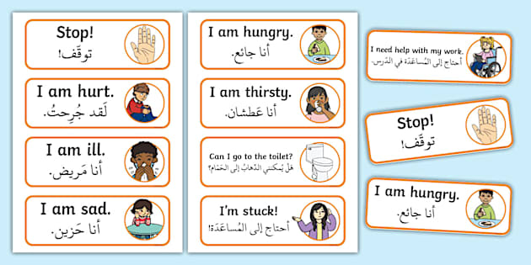


Resources
Visual timetables in different languages
Teach survival language/ ‘crash words’ for basic physiological needs e.g ‘toilet’ or ‘water’.
Duolingo: A language-learning app to support students to improve their English skills in a fun way with visuals, audio and reading.

Slide 16
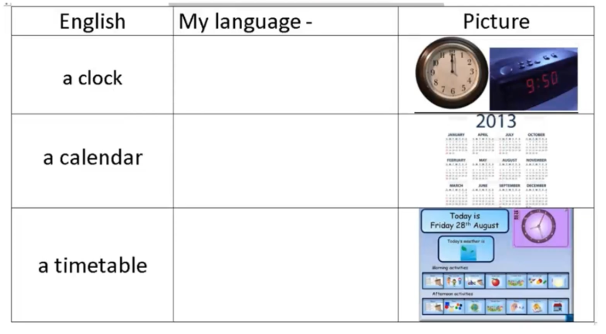

Resources
Picture dictionaries: create a visual link between a new word and its meaning using images. This way, the new arrival can form associations between the word in their home language and the English word learnt with visual prompts.
Displays with visuals and matching text in different languages

Slide 17

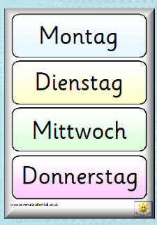

Resources
www.tesconnect.co.uk – Communication4All: resources to support inclusion for various needs and students. Includes a foreign languages section that has printable resources in various languages. See Image to the left for an example of days of the week in different languages which can be used as labels for a new arrival’s timetable initially.
WordReference: A free online dictionary with translation and dictionary resources in multiple languages. It’s useful for students to quickly look up words or phrases in both their native language and English.
Social stories with visual supports that inform the new arrival about events of the school day or general topics. AI tools can be used to create the story in a different language and visuals can be added in (see example to the left of a social story in French). A social story maybe particularly helpful before the new arrival starts the school as pictures of the environment could be included aswell as key adults.

Slide 18




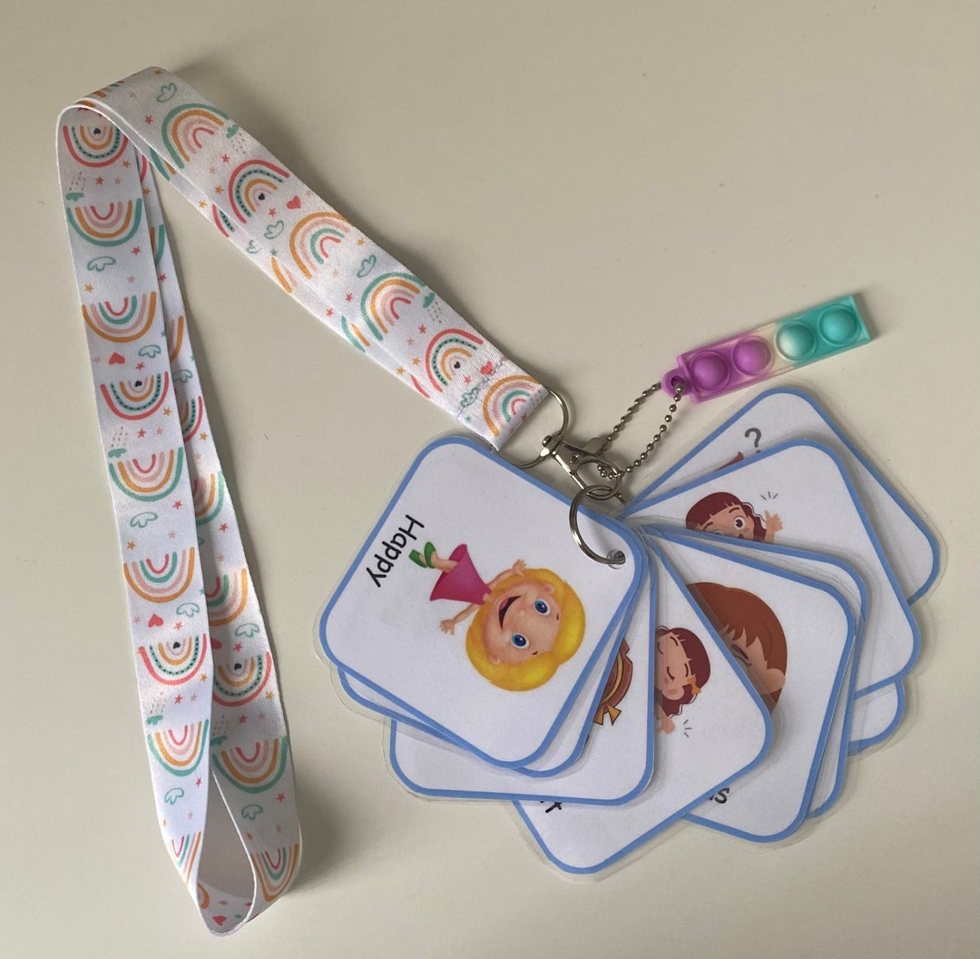
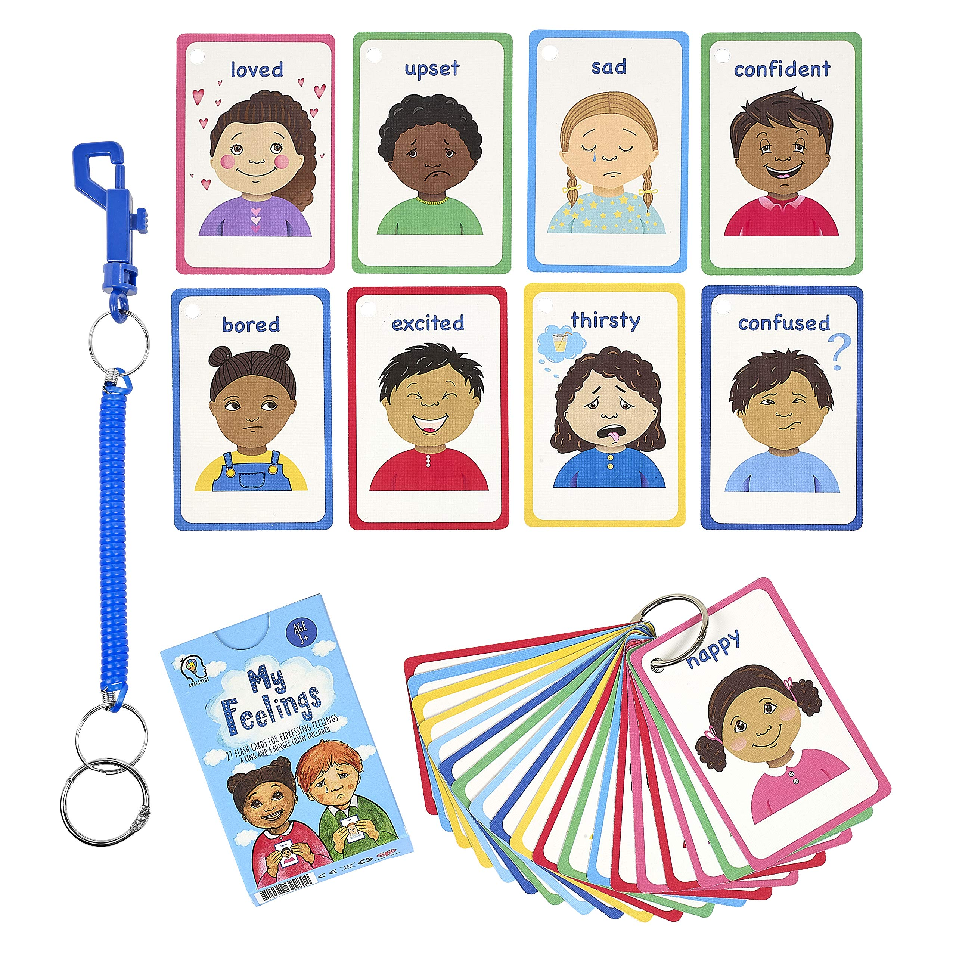
Resources
Wellbeing Support:
Mindfulness Apps/websites: Calm, Headspace, Smiling Mind etc can introduce mindfulness exercises to help children manage any feelings of anxiety etc.
Accessible visual emotions/communication cards for both staff and children - another method of communication so children can point to a card to express their emotions easily. Another example is communication fans with basic needs

Slide 19


Resources
Dual Language books/books in different languages, including audio books - once they are comfortable reading in their own language, transferrable skills can be used to support reading in English.
Smartboards and talking word programmes such as clicker 5 (can set up like colourful semantics)
Reading support: Use sequencing pictures to re-tell the story and describe what is happening in the pictures in the book.
The Bell foundation ‘The Great Ideas’ pages are a collection of different strategies that any teacher could use in their classrooms to support learners who use EAL. Link: EAL Strategies and Great Ideas - The Bell Foundation
The Bell Foundation resource library: learning resources and worksheets specifically catered to EAL learners. Link: Learning resources Archives - The Bell Foundation

Slide 20



Resources
Assessment frameworks:
NASSEA EAL assessment framework: a cross-curricular tool focusing on observing, sampling and documenting the ways bilingual pupils start to use English as a tool for learning in school. It describes the development of communicative behaviour in class and language for learning through listening, speaking, reading and writing. It covers Early years and Key stages 1-4. This can be used to gather initial baseline information of the language proficiency of a pupil and assess the new arrival in the early stages of them acquiring English as an additional language as this is when formal testing isn’t particularly helpful. This also includes guidance as to when formal assessment in line with their peer group is/isn’t appropriate.

Slide 21
Resources
Assessment frameworks:
The Bell Foundation’s assessment tools can be used to gather data to support the teaching and learning of learners who use EAL and to enable teachers to generate targets to guide progress. Through this on-going cycle of formative assessment, leading to individual target-setting and tailored support. There are assessment frameworks for EYFS, Primary and Secondary ages:
Link: EAL Assessment Framework – Primary - The Bell Foundation
Link: EAL Assessment Framework – EYFS - The Bell Foundation
Link: EAL Assessment Framework – Secondary - The Bell Foundation

Slide 22

Using Technology
Translation and Speech-to-text apps
Artificial Intelligence
Quizlet
Immersive reader
Microsoft Reading Coach
PowerPoint translator

Slide 23
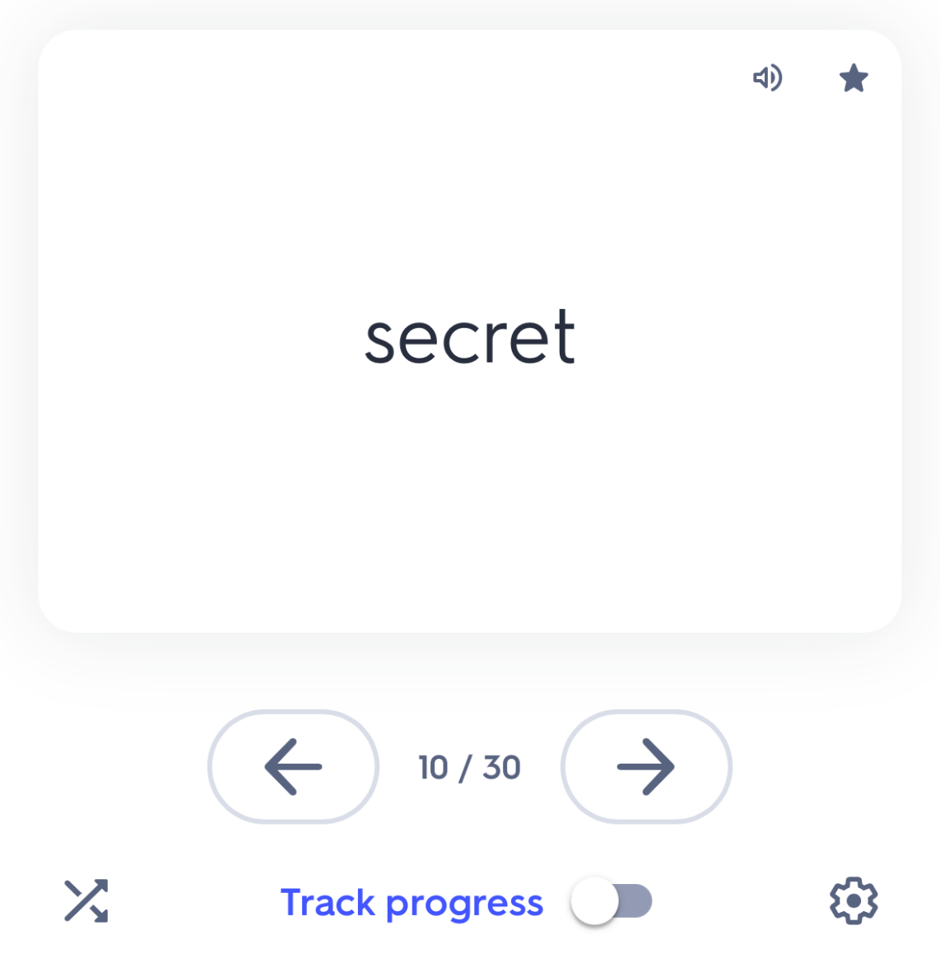
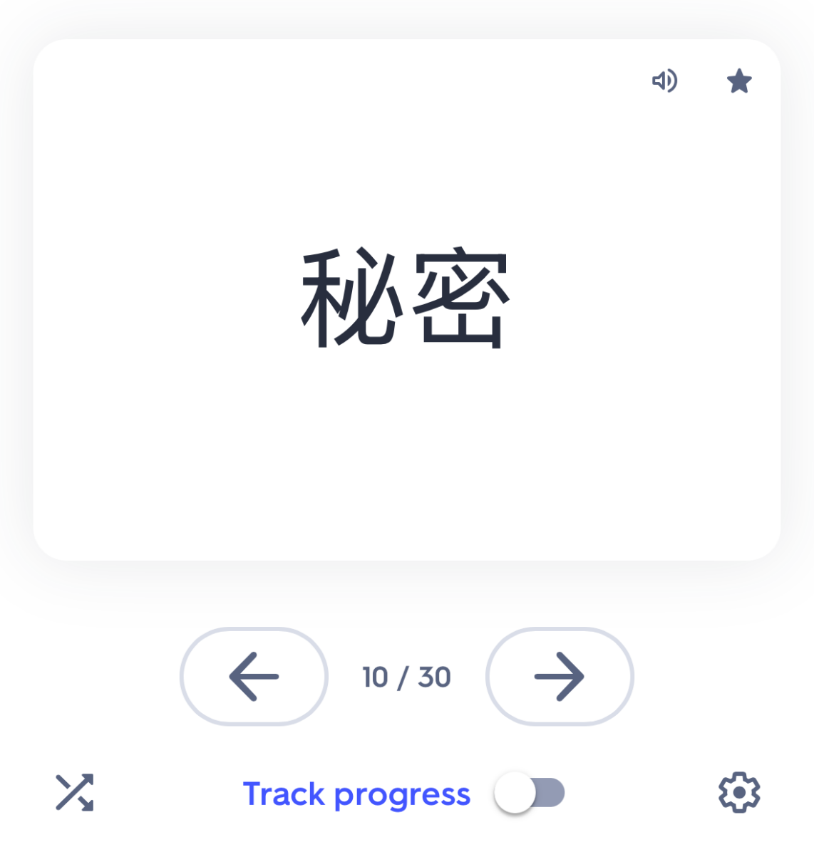
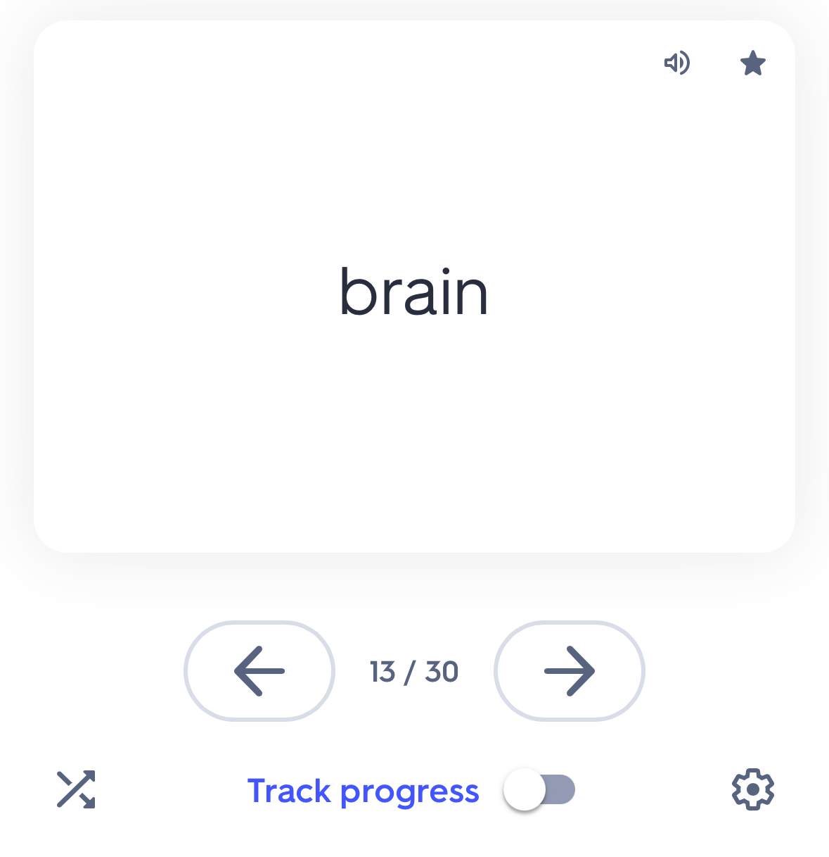
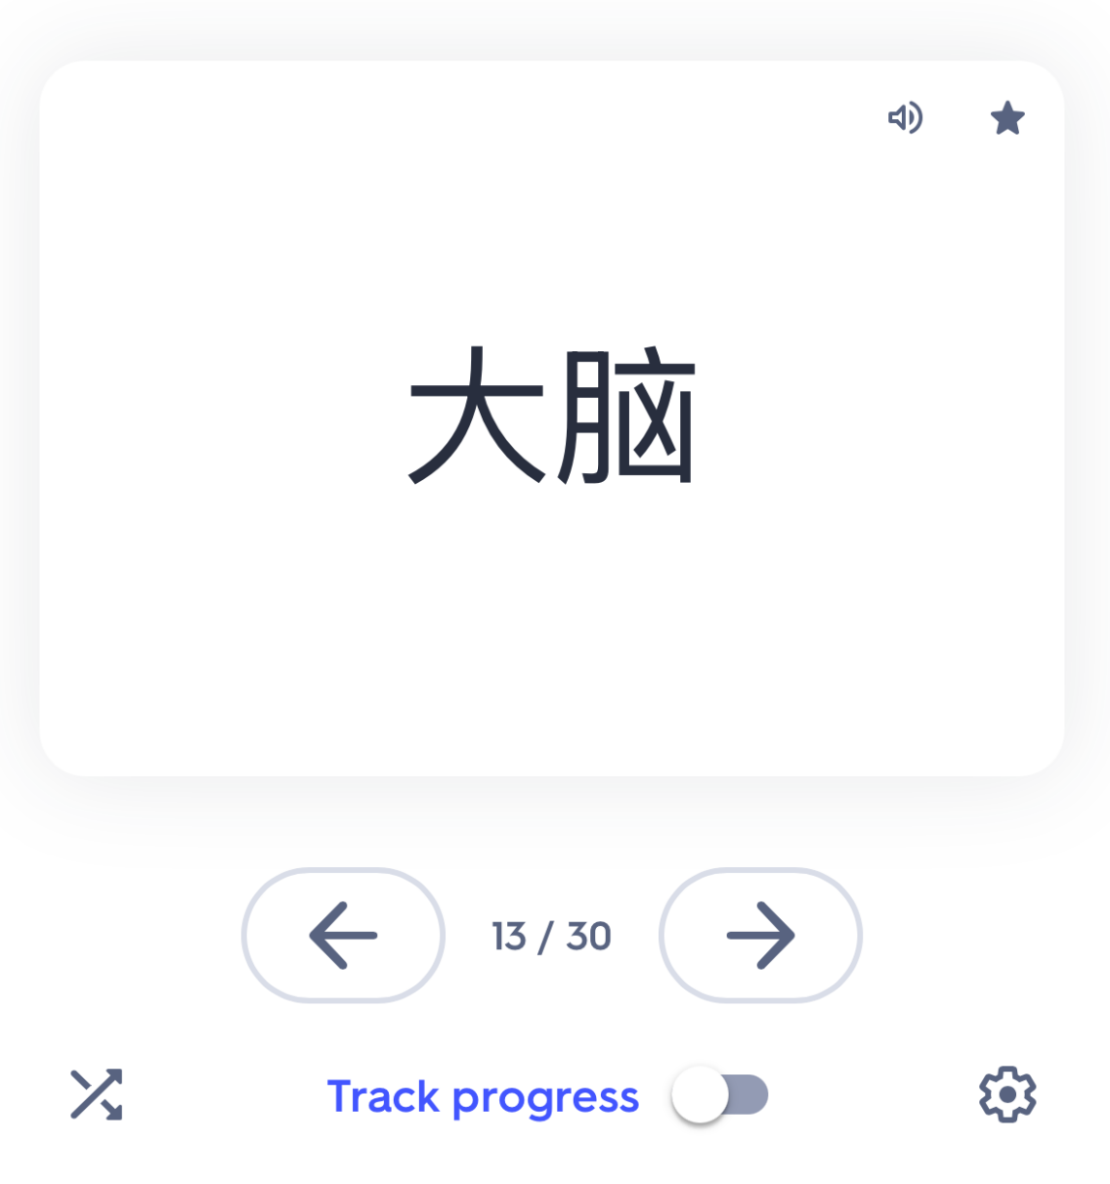
Quizlet
Allows you to create and share flashcards with visuals (and translations where needed). This is helpful for reinforcing key academic vocabulary and can even be used to pre-teach key vocabulary words. There are options to hear the words in different languages. See example of the flashcards defining words in English and Chinese (visuals can be added)
The flashcards are dual sided with audio in each language, aswell as a mini quiz at the end on the words.
DISCLAIMER: translations beyond single words may need to be cross referenced via a translation resource to ensure accuracy
Video Tutorial Link: https://youtu.be/-gY044L4IrY?si=X7A-gvFBYq4XK0fh&t=176

Slide 24

Artificial Intelligence:
AI can be used for many purposes, for example to brainstorm/generate ideas for lesson plans, translate or create texts in different languages, create worksheets and glossaries of key words for pre teaching, create word searches in different languages and support differentiation of learning content for children with English as an additional language.
Can even be used to generate images etc
AI can also be used to build on initial ideas to get the desired outcome for your lesson plans.
Examples of AI include Gemini and ChatGPT
DISCLAIMER!! – AI should only be used as an addition to high quality teaching, not a replacement! The machine can make mistakes which is why it is important the user checks through whatever output the machine provides to ensure accuracy and quality of teaching content. Data privacy must also be maintained. You know your children better than the machine – always use your professional judgement!

Slide 25
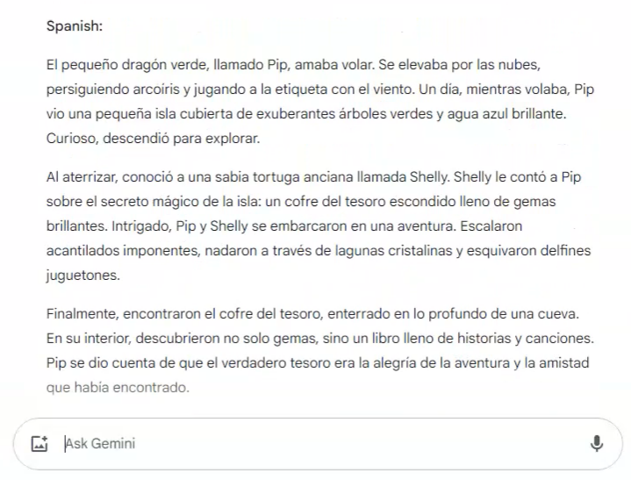
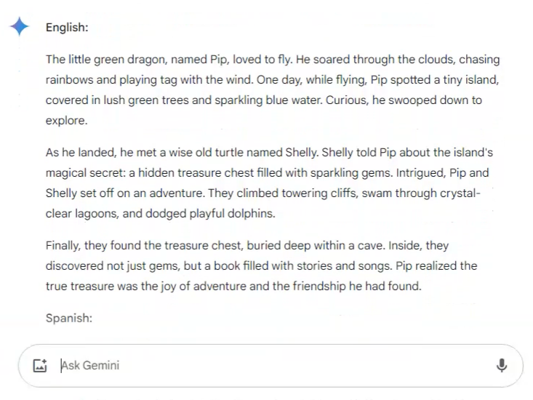
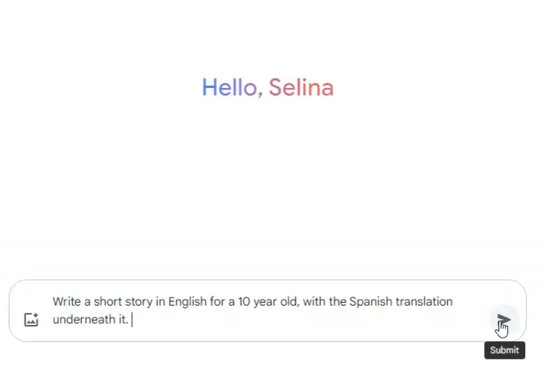
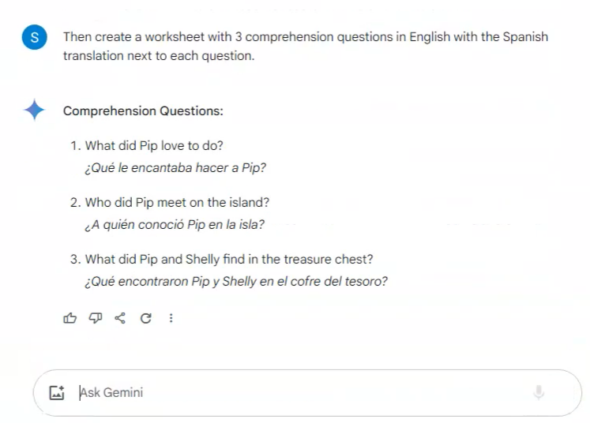
Gemini
An example of prompts that could be used for Gemini:

Slide 26
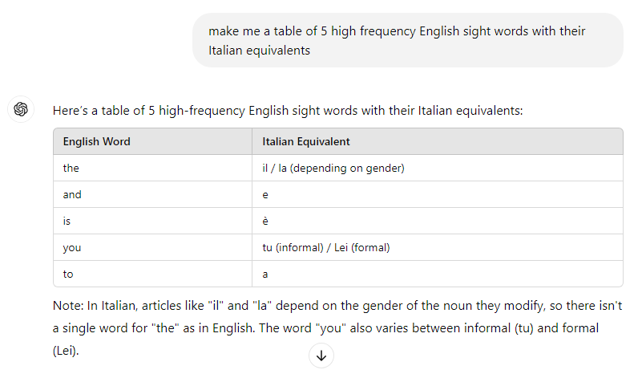
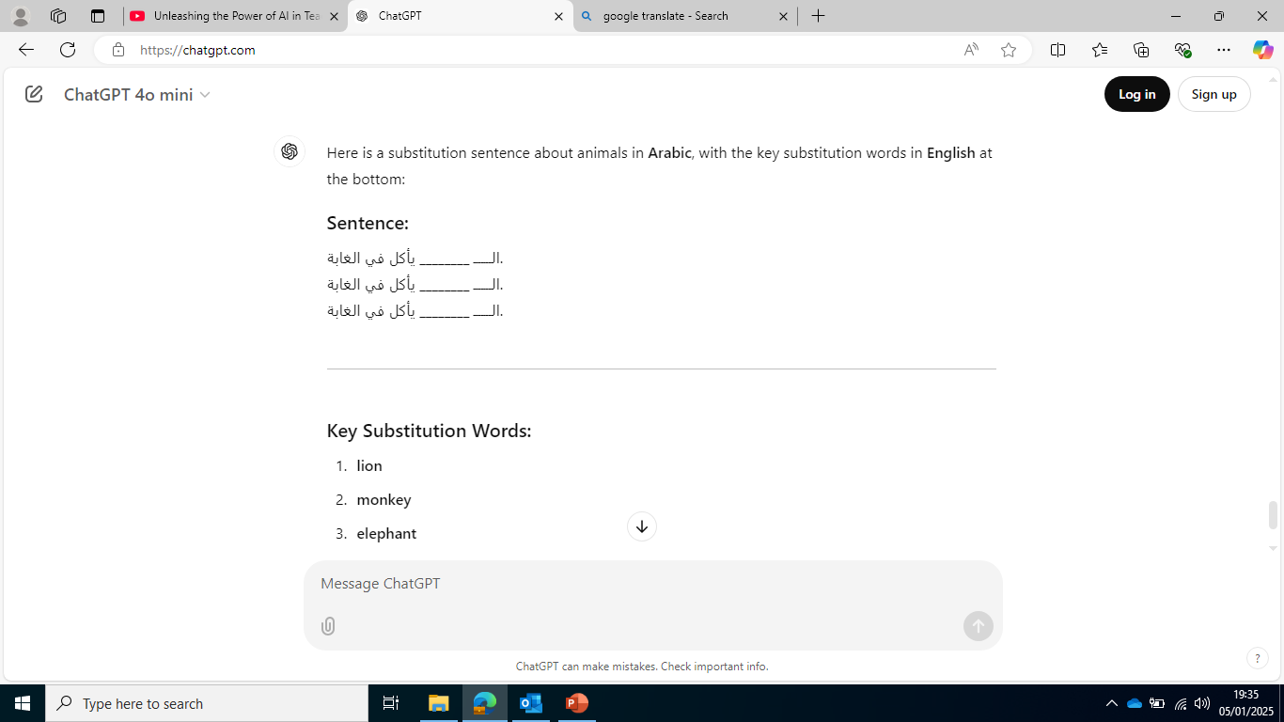
Chat GPT
The examples above show how CHAT GPT can be used for different things depending on the prompts used. The video linked below shows an in-depth example of how it can be used to build on ideas for lesson plans, including simplifying text that is too complicated to make it more suitable for different learners needs – especially in the case of English language learning
Video Tutorial Link: https://youtu.be/UgLncLJPtY4?si=DFDiyrMOmKg4HyL8&t=1420
Notes:
start video at 23:40mins

Slide 27
Other examples of Prompts
Hey Gemini, help me brainstorm ways I can make my English lesson (in line with the UK curriculum) more accessible for a year 6 student who’s first language is Chinese.
Hi ChatGPT, create me session plan for a 10 year old EAL learner whose first language is French. Make it simple, fun and include his personal interest of star wars.
Hi Gemini, simplify this text for me so it can be understood by an EAL student. Remove any complicated vocabulary that an EAL learner may struggle with.
Hey ChatGPT, write me a letter in Urdu that details this school trip for my students parents. Use the same information in the English version I have showed you.
Hey Gemini, what evidence based intervention could I use for an EAL learner to support them in understanding their emotions?

Slide 28
Microsoft Reading Coach
Allows the user to practise pronunciation and accuracy of reading as well as AI generated focal points for key words to practise.
Allows built in AI generated stories at different levels to support the user to read according to their current ability.
Lots of options for different languages as well as inputting your own story/text to read.

Slide 29

Microsoft Reading Coach

Slide 30
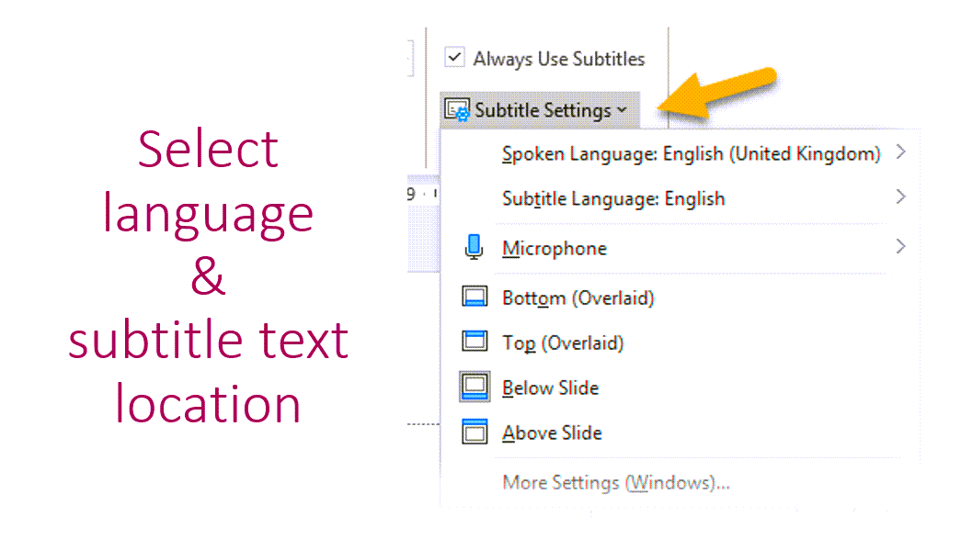
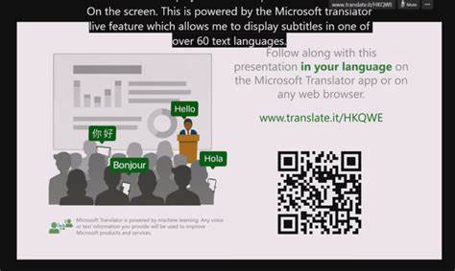
PowerPoint Translator with subtitles
Video Tutorial Link: Translating: Using PowerPoint Subtitles

Slide 31
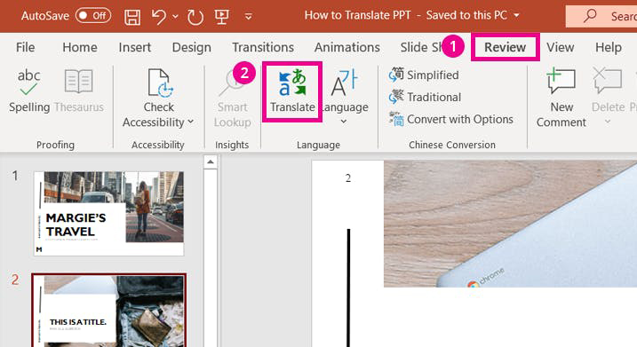
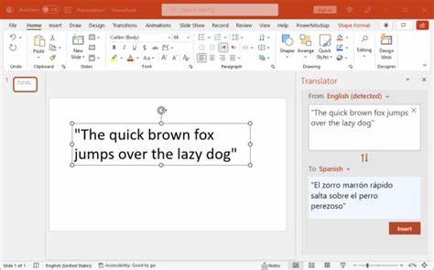
PowerPoint Translator
Video Tutorial Link: https://youtu.be/vJlEwIxpFZ0?si=ZgD6qFIm0SmcYFls
Detailed information page: https://www.microsoft.com/en-us/translator/business/powerpoint/

Slide 32

Immersive Reader
Helps to improve reading skills for all ages and abilities. Immersive Reader shows text in a window where you can have it read aloud (and in different language) or formatted in ways that enhance reading, such as words divided into syllables, colour coded and tagged for parts of speech, or extra spacing between words and lines.

Slide 33
Immersive Reader – Word Desktop

Slide 34
Immersive Reader – Word online

Slide 35
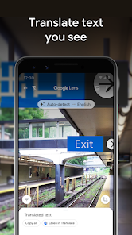

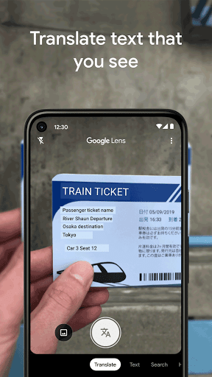
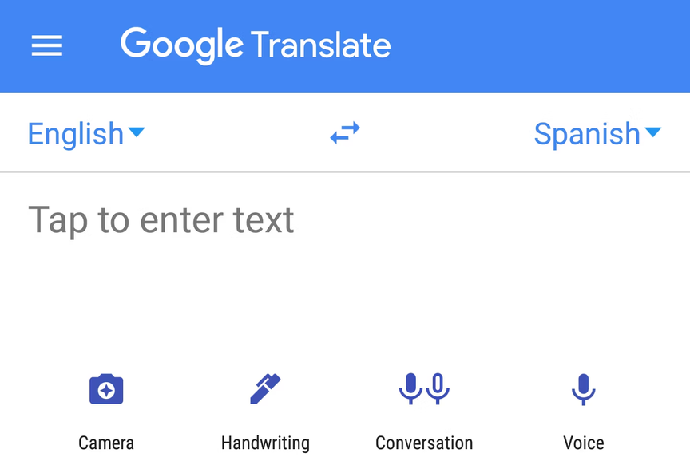
Translation/Speech-to-text Apps: Google
Translation Apps allow you to type in a text in English and select a language you would like to translate it into. This is useful for real-time language translation
Speech-to-Text apps: for students who are still getting comfortable with writing in English. This can help students articulate their thoughts more easily and ensure their voice is heard.
Open Google Lens and select the translate option
Direct your camera at the text for live translation
OR take a photo and then it will translate

Slide 36
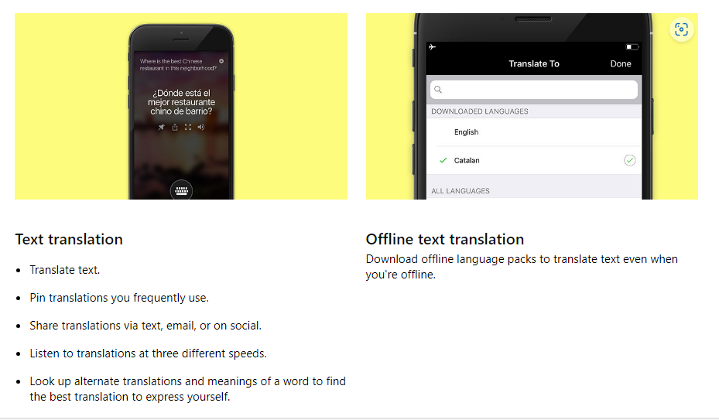

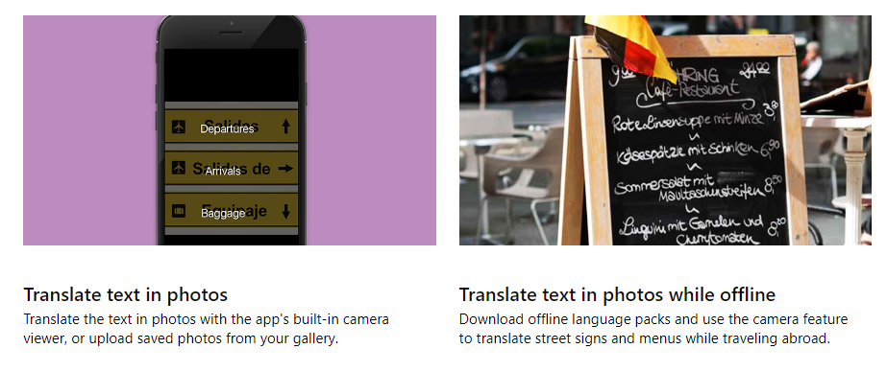
Translation/Speech-to-text Apps:
Microsoft Translator
App Features - Microsoft Translator
Video Tutorial Link: https://youtu.be/16yAGeP2FuM?si=IJtJQ80HInq1h35X

Slide 37
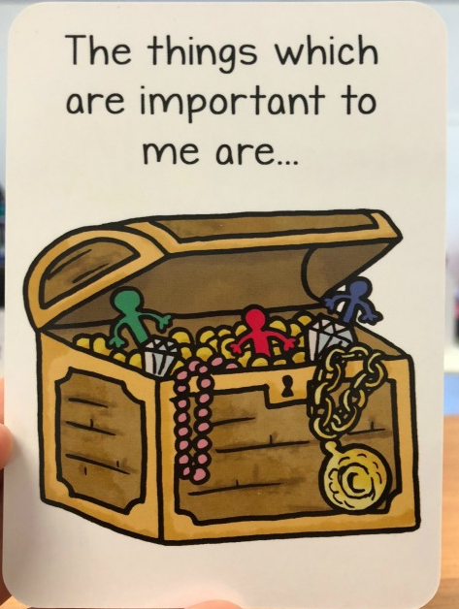
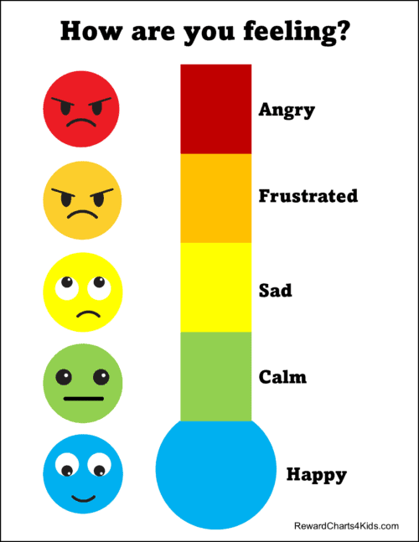
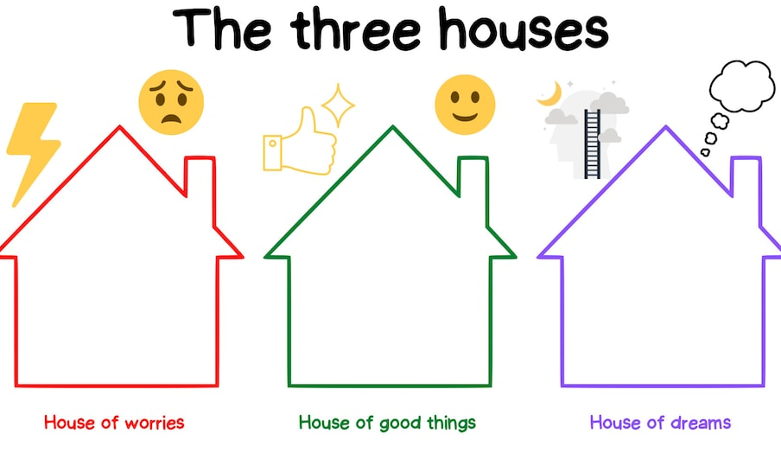
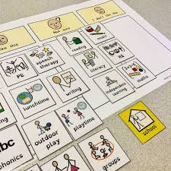
Pupil voice
highland-council-psychological-service-tools-for-gathering-the-views-of-children-and-young-people-may-2020.pdf
Gather pupil voice and revisit this regularly as they settle. This will inform any plans or support put in place. See examples of how to do this below aswell as links for further information:
Creating talking mats using widget with labels in different languages to explore interests, areas of strength/ difficulty and to gather information.
Using translation apps to aid check-ins
3 houses approach – simplify and use visual aids/translation apps to find out what their worries, strengths and hopes/dreams are.
Ideal school, classroom, peers, teachers – use visual prompts to explore. Drawing-the-Ideal-School.pdf
‘All about Me’ folder/book with pictures, drawings/things that are important to them.
Emotions cards and card sorting tasks
Visual Rating scales/ emotions thermometers

Slide 38
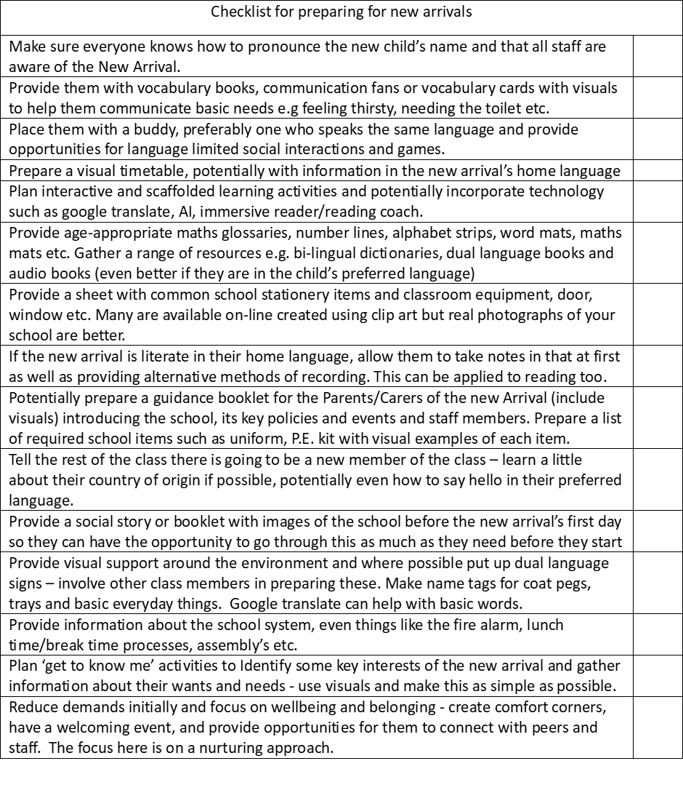
Checklist for preparing for new arrivals

Slide 39
Further reading/Resources
The Bell Foundation – information around evidence-based language education (very informative YouTube videos on different aspects of supporting EAL learners!) Also have an assessment framework and progress tracker tool, worksheets and activities. The Bell Foundation - Changing lives and overcoming exclusion through language education
NASSEA – the website has a wealth of resources for improving teaching and learning of EAL, black and minority ethnic students, eg EAL assessment framework including an EYFS version; Maths word list; cultural calendar. Nassea | Improving teaching and learning for black and minority ethnic pupils
Guidance for the assessment of newly arrived pupils learning English as an additional language in Key Stages 1 and 2: PDF VERSION
Welcoming Newly Arrived Bilingual Pupils: New Arrivals
Milton Keynes Council guidance for induction, assessment, well-being and other areas of support: https://www.milton-keynes.gov.uk/schools-and-lifelong-learning/ethnic-minority-achievement/newly-arrived-international-pupils
Research on EAL learners’ own accounts of their experiences: CERES_Executive_summary.pdf

