Slide 1
Operational overview of Family Hubs in Oldham:
Meeting the needs of our children and young people and their families
March 25

Slide 2



Family Hubs Principles
ACCESS
RELATIONSHIPS
ACCESS
CONNECTIONS
CONNECTIONS
RELATIONSHIPS
FAMILY HUBS NATIONAL FRAMEWORK
More accessible
Better connected
More relationship-centred
There is a clear, simple way for families to access help and support through a hub building and approach.
There are professionals working together, through co-location, data sharing and a common approach to their work.
The family hub prioritises strengthening relationships, and builds on family strengths.
Notes:
The programme will:
provide support to parents and carers so they are able to nurture their babies and children,
contribute to a reduction in inequalities in health and education outcomes for babies, children and families across England by ensuring that support provided is communicated to all parents and carers, including those who are hardest to reach and/or most in need of it
build the evidence base for what works when it comes to improving health and education outcomes for babies, children and families in different delivery contexts
The programme will do this by:
Transforming the way services are designed and delivered
Universal start for life and family services
Tailored support for vulnerable communities
Workforce capacity and capability
Understanding what works and sharing best practice

Slide 3
Themed areas
PIMH
Parenting
Speech, Language and Communication/Home Learning Environment
Parent Panels
Infant Feeding
FAMILY HUBS IN OLDHAM
Notes:
£3 million pounds funding for 3 years, currently in year 2, programme ends March 2025.
Main areas where the DfE have prioritised funding.
Expectations to deliver a full 0 – 19 offer through integrated and partnership working

Slide 4
Family Hubs in Oldham Update May 2024
7 hubs – Central Library, 6 Children's Centres: Beever, Stanley Road, Medlock Vale, Springmeadows, Shaw, Alexandra
Developing the range of services being delivered in the hubs
FAMILY HUBS IN OLDHAM
Notes:
5 district family hubs – 1 per district – yet to be decided – could be CC or library, leisure centre. We are hoping they will be CC’s
If they are not Family hubs, they will become delivery points (spokes) for family hubs.

Slide 5
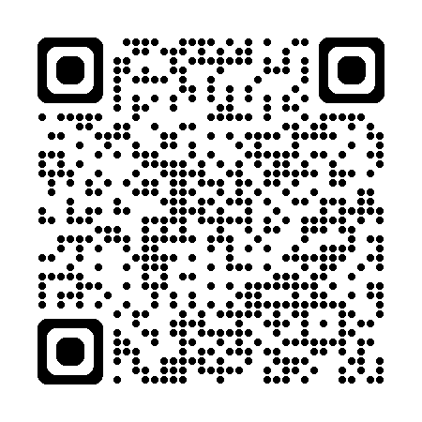
Family Hub Website

